Slide 1
FIN4811
Risk Management
Chapter Two
Market Risk
Nattanan Bovornsantisuth

Slide 2
Agenda
Introduction to Market Risk
Sensitivity Analysis
VaR Measurement Model
Expected Shortfall

Slide 3
What is Market Risk?
Definition – ERM and Financial
ERM
Financial
The exposure to a potential loss arising from diminishing sales or margins due to changes in market conditions, outside of the control of the business
Market risk, or the risk of loss (or gain) arising from unexpected changes in market prices
Risk factors can be classified into interest rate, equity , exchange rate.

Slide 4
Market Risk Measurement
Volatile Environment
Stock market volatility. Stock markets have always been volatile, but sometimes extremely
Exchange rate volatility. Exchange rates have been volatile ever since the breakdown of the Bretton Woods system of fixed exchange rates in the early 1970s. Occasional exchange rate crises have also led to sudden and significant exchange rate changes
Interest rate volatility. There have been major fluctuations in interest rates, with their attendant effects on funding costs, corporate cash flows and asset values.
Commodity market volatility. Commodity markets are notoriously volatile, and commodity prices often go through long periods of apparent stability and then suddenly jump by enormous amounts

Slide 5
Market Risk Measurement
Sensitivity Analysis
Sensitivity Analysis is to measure the magnitude of market value of the instruments changing comparing to the fluctuation of market risk factors.
There are several sensitivity methods to measure
Risk Factors | Sensitivity methods
Interest Rate | Modified Duration Basis Point Value (PV01)
Exchange Rate | Greek Value
Equity | Beta

Slide 6
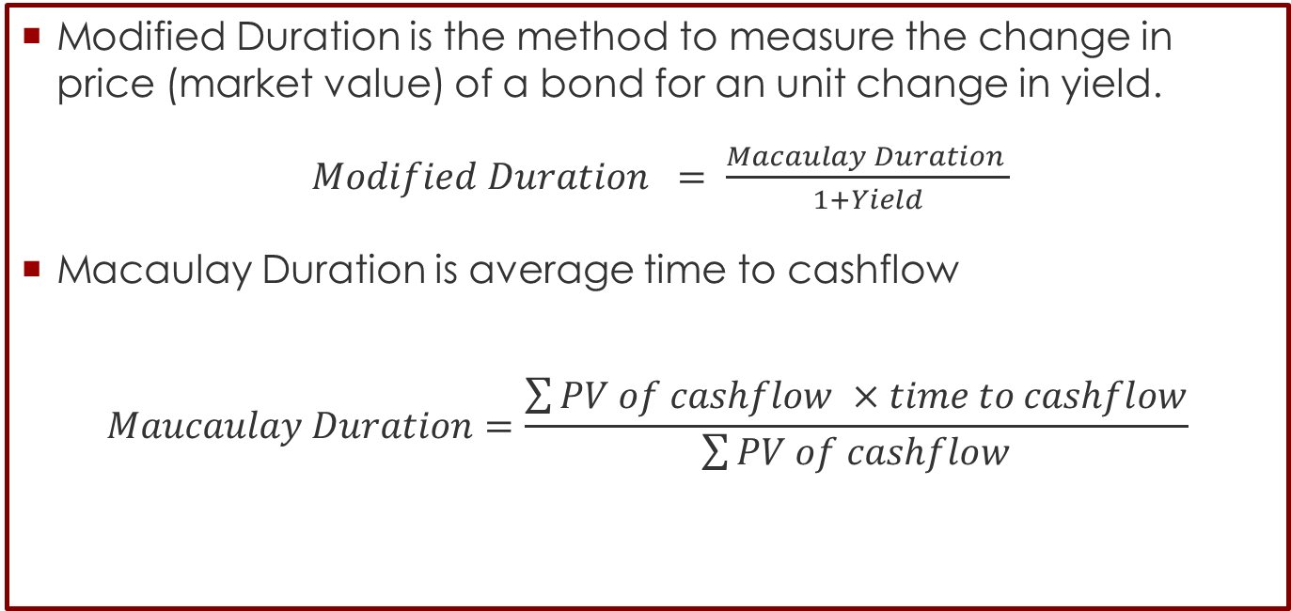
Market Risk Measurement
Modified Duration
Modified Duration is the method to measure the change in price (market value) of a bond for an unit change in yield.
$Modified Duration = \frac{Macaulay Duration }{1+Yield}$
Macaulay Duration is average time to cashflow
$$Maucaulay Duration=\frac{\sum{PV of cashflow ×time to cashflow}}{\sum{PV of cashflow}}$$

Slide 7
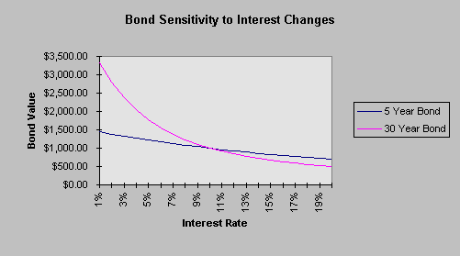
Market Risk Measurement
Basis Point Value

Slide 8
Market Risk Measurement
Modified Duration
Example: 10 Year € Swap note future
Macaulay Duration = 8.1696 years
Modified Duration = 8.1696 / (1 + 1.776%) = 8.0270
Percentage price change = -duration x change in yield x market value
Sensitivity = -8.0270 x 1% x 138.39 = -11.10857
Maturity date | Adjusted Cash flow date | Cash flow | Discount Cashflow | Time to Cashflow
1 | 20-Jun-13 | 6 | 5.8953 | 1
2 | 20-Jun-14 | 6 | 5.7924 | 2
3 | 22-Jun-15 | 6.03333336 | 5.723 | 3.00555556
4 | 20-Jun-16 | 5.96666664 | 5.5609 | 4
5 | 20-Jun-17 | 6 | 5.4944 | 5
6 | 20-Jun-18 | 6 | 5.3985 | 6
7 | 20-Jun-19 | 6 | 5.3043 | 7
8 | 22-Jun-20 | 6.03333336 | 5.2407 | 8.00555556
9 | 21-Jun-21 | 5.98333332 | 5.1066 | 9.00277778
1 | 20-Jun-22 | 105.98333 | 88.8751 | 10

Slide 9
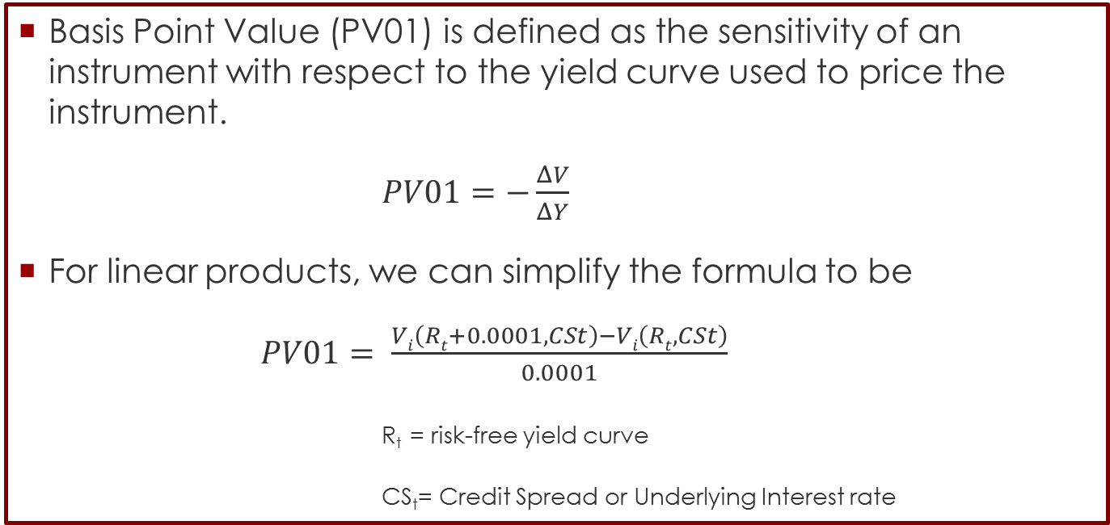
Market Risk Measurement
Basis Point Value
Basis Point Value (PV01) is defined as the sensitivity of an instrument with respect to the yield curve used to price the instrument.
$PV01=−\frac{ΔV}{ΔY}$
For linear products, we can simplify the formula to be
$PV01= \frac{Vi\left(Rt+0.0001,CSt\right)−Vi\left(Rt,CSt\right)}{0.0001}$
R_{t} = risk-free yield curve
CS_{t}= Credit Spread or Underlying Interest rate

Slide 10
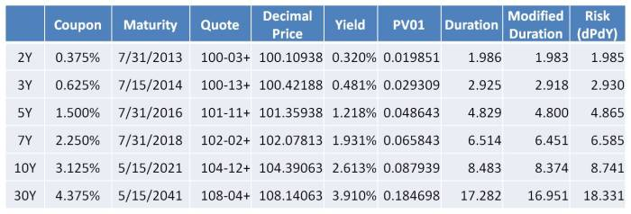
Market Risk Measurement
Basis Point Value
Example
Returning to the 5Y Treasury, we see that PV01 is 0.048643. So if interest rates were to go up by 0.01%, the price would fall by this decimal figure. If the yield were to increase by 0.02%, then price would fall by twice this amount. Conversely, if yield were to decrease by 0.01%, price would rise by 0.048643.

Slide 11
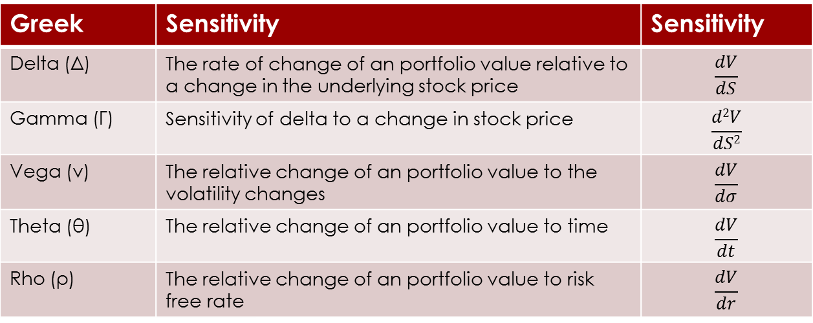
Market Risk Measurement
Greek Sensitivity
For the derivatives transactions, they are classify as non linear products, so in order to find the sensitivity, Greek letter will be used.
Greek | Sensitivity | Sensitivity
Delta (Δ) | The rate of change of an portfolio value relative to a change in the underlying stock price | $$\frac{dV}{dS}$$
Gamma (Γ) | Sensitivity of delta to a change in stock price | $$\frac{d2V}{dS2}$$
Vega (ν) | The relative change of an portfolio value to the volatility changes | $$\frac{dV}{dσ}$$
Theta (θ) | The relative change of an portfolio value to time | $$\frac{dV}{dt}$$
Rho (ρ) | The relative change of an portfolio value to risk free rate | $$\frac{dV}{dr}$$

Slide 12
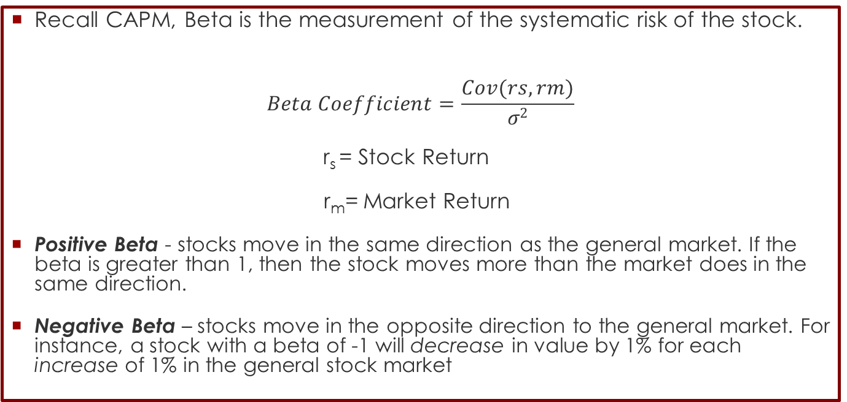
Market Risk Measurement
Beta (β)
Recall CAPM, Beta is the measurement of the systematic risk of the stock.
$$Beta Coefficient=\frac{Cov(rs,rm)}{σ2}$$
r_{s} = Stock Return
r_{m}= Market Return
Positive Beta - stocks move in the same direction as the general market. If the beta is greater than 1, then the stock moves more than the market does in the same direction.
Negative Beta – stocks move in the opposite direction to the general market. For instance, a stock with a beta of -1 will decrease in value by 1% for each increase of 1% in the general stock market

Slide 13
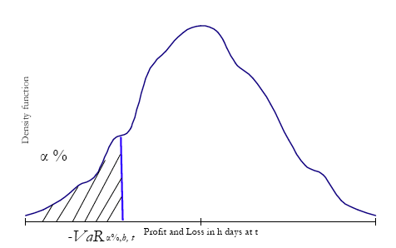
Market Risk Measurement
Value at Risk (VaR)
Proposals for the disclosure of Market risk call for firm wide measures of risk.
A standard benchmark is the value at risk ,VaR, For a given time horizon t and confident level α % the value at risk is the loss in market value over the time horizon t that is exceeded with probability (1-α)
maximum amount of would have at 1-α% portfolios would lose more than VaR

Slide 14
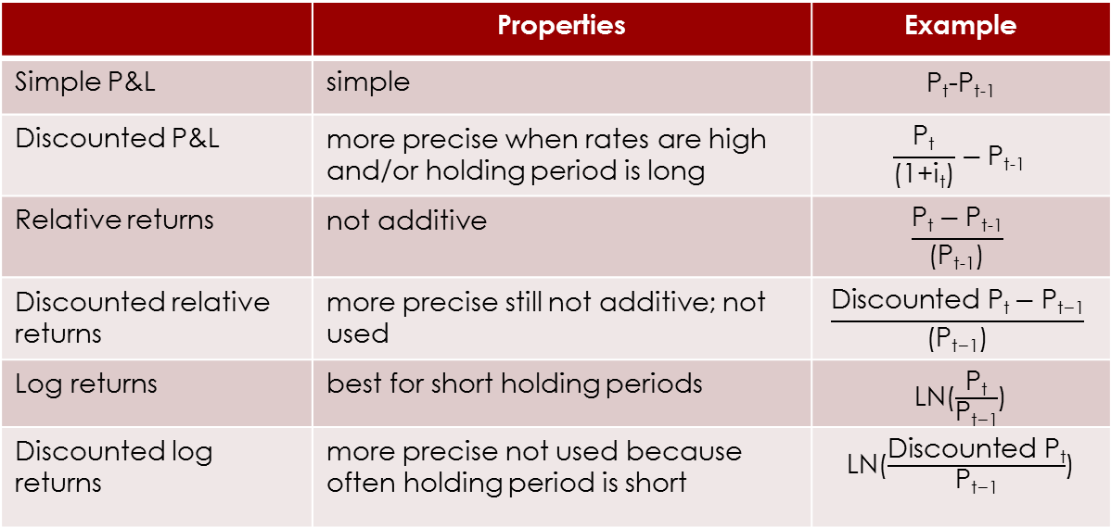
Market Risk Measurement
Data
Raw data: prices To estimate VaR, the following transformation can be used:
 | Properties | Example
Simple P&L | simple | P_{t}-P_{t-1}
Discounted P&L | more precise when rates are high and/or holding period is long | $$\frac{\text{P}\text{t}}{\text{(1+}\text{it}\text{)}}−\text{P}\text{t}\text{−1}$$
Relative returns | not additive | $$\frac{\text{P}\text{t}−\text{P}\text{t}\text{−1}}{\text{(}\text{Pt}\text{−1)}}$$
Discounted relative returns | more precise still not additive; not used | $$\frac{\text{Discounted} \text{Pt}−\text{P}\text{t}\text{−1}}{\text{(}\text{Pt}\text{−1)}}$$
Log returns | best for short holding periods | LN($\frac{\text{P}\text{t}}{\text{P}\text{t}\text{−1}}$)
Discounted log returns | more precise not used because often holding period is short | LN($\frac{\text{Discounted} \text{P}\text{t}}{\text{P}\text{t}\text{−1}}$)

Slide 15
Market Risk Measurement
Measurement Level
VaR can be measured at two levels:
Portfolio level: the risk factor is the portfolio itself; more precisely the risk sources are not identified. The VaR of the portfolio is computed from historical data on the portfolio or from properties of the portfolio
Portfolio No.1
Portfolio No.2
Bond
Stock
Stock
Unit trust
FX
Commodity
FX Option

Slide 16
Market Risk Measurement
Measurement Level
Risk factor level: the risk of the portfolio is attributed to different sources, called risk factors. The risk factors are identified and the sensitivity of the portfolio to these risk factors is measured. This is much better than portfolio level measurement when trading strategies change!
  The VaR of the portfolio is computed from historical data on the risk factors or from properties of the risk factors, using the sensitivities.
Interest rate
FX
Equity
Bond
FX
Stock
FX Forward
Unit trust
IRS
CCS
FX option
EQ option

Slide 17
Market Risk Measurement
Value at Risk (VaR)
Parameter choice:
significance level α% (confidence level 1 – α%): depends on objectives and regulation; also for example on the desired credit rating that depends on default probability
  e.g. if you want to compute the capital that can cover losses that happen 99 days out of 100, then use α% = 1%.
    α% small for capital requirements, high for back-testing
Holding period / risk horizon: depends on the optimal hedging period and on the liquidity of the assets (liquidity decreases in stress markets!)
  e.g. h = 10 days for estimation of RC and 1 day for estimation of EC
    short periods for both capital requirements and back-testing

Slide 18
Value at Risk (VaR)
Historical VaR – Methodology
Assumptions
  Only one risk factor: the portfolio itself
  Future behavior of the portfolio will replete the past
  No distribution assumption about risk factors
Calculation (using P&L Data)
  Using historical data and construct P&L series for the portfolio
  This P&L will be measured over a given holding period (e.g. 1 day)
  This will give P&L distribution
−VAR_{α%,h,T} = the lower percentile of this density

Slide 19
Value at Risk (VaR)
Historical VaR – Methodology
Methodology
  Create weight to each observation:
  Order the P&L observation in increasing order
  Compute cumulative weight
  −VaR_{α%} will be the value that has cumulative weight = α%
Weight = 1/N

Slide 20
Value at Risk (VaR)
Age-weighted historical VaR
Previously, when computing VaR we used the same weight for each historical observation
There are periods characterized by larger or smaller volatility (caused by some event) or that are of less importance (like older data)
When computing VaR, then more volatile data periods should be ‘normalized’ by their volatility; similarly, older data should have less weight

Slide 21

Value at Risk (VaR)
Age-weighted historical VaR
Methodology
  Because weight will give the high priority to the newer data so weight will calculate according to:
      where λ = decay factor
  Order the P&L observation in increasing order
  Compute cumulative weight
  −VaR_{α%} will be the value that has cumulative weight = α%

Slide 22
Value at Risk (VaR)
Historical VaR – Methodology
Properties:
  This method does not assume any distribution
  Rely mostly on the assumption that the future will replete the past.
Pros
  Full valuations of assets.
  No distribution assume
  Allow weight to be added to the observations to different criteria
Cons
  Future behavior may differ from the past
  Assume stable market conditions
  Lot of data is needed.

Slide 23
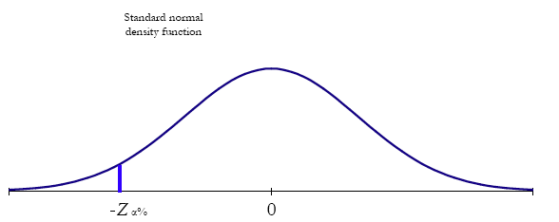
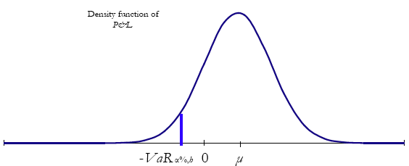
Value at Risk (VaR)
Normal Linear VaR – Methodology
Zero Mean P&L_{h,t} ~ N(0, σ²_{h}): VaR_{α%, h, t} = -Z_{α%} * σ_{h} + µ

Slide 24
Value at Risk (VaR)
Normal Linear VaR – Methodology
Assumption:
  P&L is the only risk factor & it is independent and identically distributed (iid) normally distributed
VaR_{α%, h, t} = -Z_{α%} * σ_{h} + μ_{h}
– VaR_{α%, h, t} is the lower α percentile of the P&L distribution:
P(P&L_{h,t} ≤ – VaR_{α%, h, t}) = α%
– Z_{α%} is the lower α percentile of the standard normal distribution:
P(z ≤ – Z_{α%}) = α%

Slide 25
Value at Risk (VaR)
Normal Linear VaR – Methodology
Compute the VaR for a portfolio for h = 1 day and 10 days
α% = 1%; µ1 day = £ 5,000; σ1 day = £ 20,000
VaR_{1%, 1 day} = -Z_{99%} * σ + µ
= -2.32634 * 20,000 + 5,000
= £-41,527
VaR_{1%, 10 days} = -Z_{99%} * σ₁₀ + µ₁₀
= -2.32634 * 20,000 * √10 + 5,000 * 10
= £ -97,131
Note. For scaling from 1 day to 10 days, we multiply √10.

Slide 26
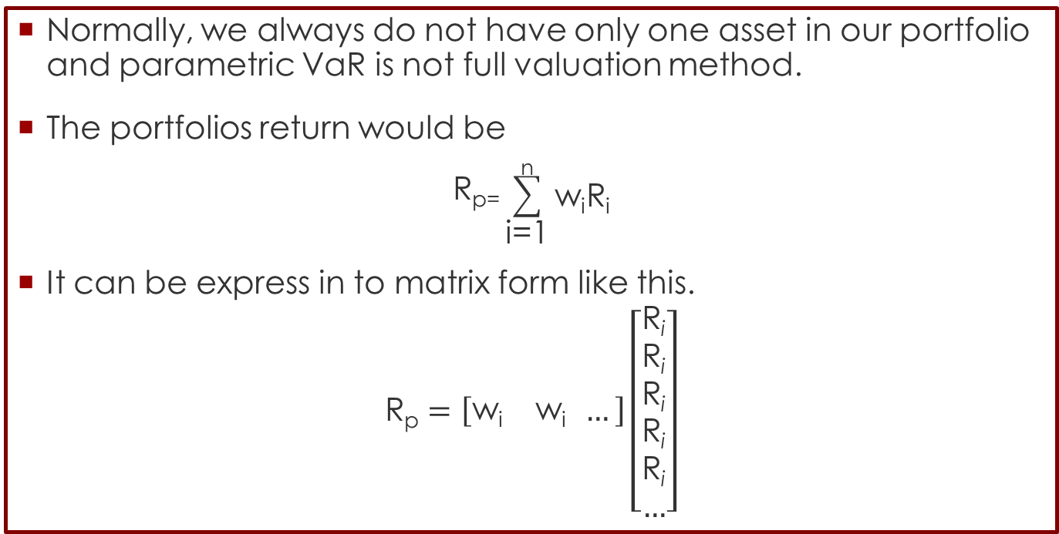
Value at Risk (VaR)
Normal Linear VaR – Multi Assets
Normally, we always do not have only one asset in our portfolio and parametric VaR is not full valuation method.
The portfolios return would be
$$\text{R}\text{p}\text{=}\sum_{\text{i}\text{=1}}^{\text{n}}{\text{w}\text{i}\text{R}\text{i}}$$
It can be express in to matrix form like this.
$$\text{R}\text{p}=\left[\begin{matrix}\text{w}\text{i} & \text{w}\text{i} \end{matrix} …\right]\left[\begin{aligned}\text{R}\text{i} \\ \text{R}\text{i} \\ \text{R}\text{i} \\ \text{R}\text{i} \\ \text{R}\text{i} \\ …\end{aligned}\right]$$

Slide 27

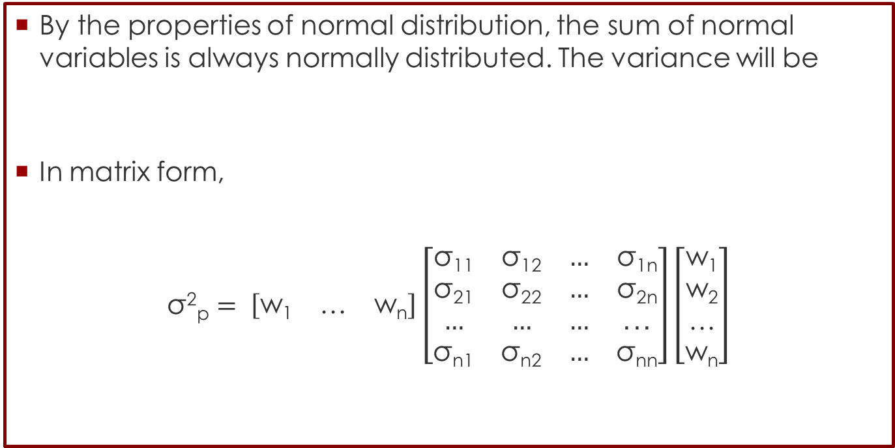
Value at Risk (VaR)
Normal Linear VaR – Multi Assets
By the properties of normal distribution, the sum of normal variables is always normally distributed. The variance will be
In matrix form,
$$\text{σ}\text{2}\text{p}= \left[\begin{matrix}\text{w}\text{1} & \text{…} & \text{w}\text{n}\end{matrix}\right]\left[\begin{matrix}\text{σ}\text{11} & \text{σ}\text{12} & … & \text{σ}\text{1}\text{n} \\ \text{σ}\text{21} & \text{σ}\text{22} & … & \text{σ}\text{2}\text{n} \\ … & … & … & ... \\ \text{σ}\text{n}\text{1} & \text{σ}\text{n}\text{2} & … & \text{σ}\text{nn}\end{matrix}\right]\left[\begin{matrix}\text{w}\text{1} \\ \text{w}\text{2} \\ \text{…} \\ \text{w}\text{n}\end{matrix}\right]$$
$$\text{σ}\text{2}\text{p} \text{=}\sum_{\text{i}\text{=1}}^{\text{n}}{\sum_{\text{j}\text{=}\text{1}}^{\text{n}}{\text{w}\text{i}}\text{w}\text{j}\text{σ}\text{i}\text{j}}$$

Slide 28
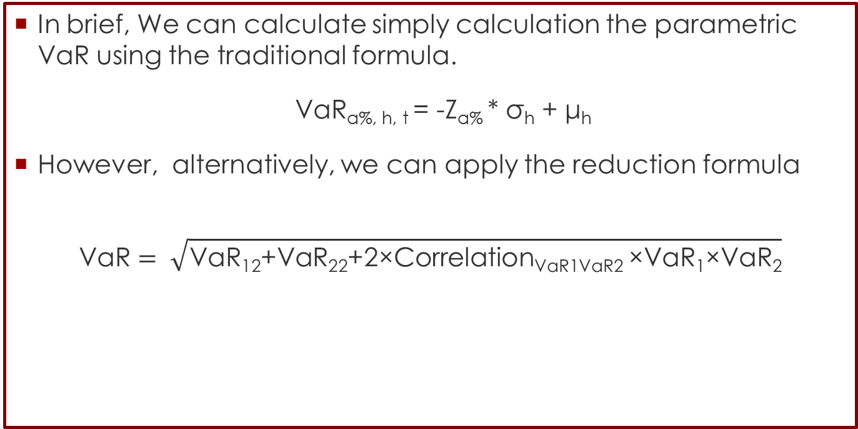
Value at Risk (VaR)
Normal Linear VaR – Multi Assets
In brief, We can calculate simply calculation the parametric VaR using the traditional formula.
VaR_{α%, h, t} = -Z_{α%} * σ_{h} + μ_{h}
However, alternatively, we can apply the reduction formula
$$\text{VaR}= \sqrt{\text{VaR}\text{12}\text{+}\text{VaR}\text{22}\text{+2}\text{×}\text{CorrelationVaR}\text{1}\text{VaR}\text{2 }\text{×}\text{VaR}\text{1}\text{×}\text{VaR}\text{2}}$$

Slide 29
Value at Risk (VaR)
Normal Linear VaR – Methodology
Properties
  Assumes normal distribution
  Relies on parameters estimated from historical data
Pros
  Simple to use
Cons
  Assumes normality
  Assumes stable market conditions
  Not suitable when there are discontinuous payoffs in the portfolio

Slide 30

Value at Risk (VaR)
Monte Carlo VaR – Methodology
Assumption
  The price S_{t} of a stock is moving under Brownian motion following by this equation
So, we simulating n standard normal variables we get one final stock price S_{T}
Thus, VaR_{α%} will be the lower α% percentile of this density

Slide 31
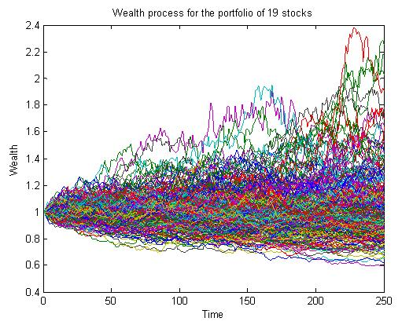
Value at Risk (VaR)
Monte Carlo VaR – Methodology

Slide 32
Value at Risk (VaR)
Monte Carlo VaR – Methodology
Properties
  Assumes normal distribution (can be changed)
  Relies on parameters estimated from historical data
Pros
  It can capture different market behaviors
  It can model complicated dependencies
  It can model the tails of the payoff distributions
  It can model extreme events
Cons
  Computer intensive
  Assumes a standard distribution
  Assumes stable market conditions

Slide 33
Value at Risk (VaR)
Comparison
 | Historical VaR | Normal VaR | Monte Carlo VaR
Risk factor distribution | No assumption | Normal | Normal
P&L distribution | Empirical | Normal | Simulation
Requires covariance matrix | No | Yes | Yes
Risk factor independent and identical | Yes | Yes | Yes

Slide 34
Market Risk Measurement
Value at Risk (VaR)
Scaling VaR
For linear portfolios (not for options) we can compute h-day VaR from 1-day VaR (assuming iid normal returns and constant weights OR iid normal risk factors and constant risk factor sensitivities):
VaR_{α%, h, t} = √h * VaR_{α%, 1 day, t} + μ_{1 day} * (√h – h)
if μ1 day = 0 (a reasonable assumption for short holding periods):
VaR_{α%, h, t} = √h * VaR_{α%, 1 day, t}

Slide 35
Value at Risk (VaR)
Advantages
Simple & easy, it expresses risk in one number
It tells you how much is the expected maximum loss at your preference of confident level.
It can be extended to other types of risks (credit, operational)
    It gives a unified framework for risk management
It can be broken down for units of the firm
It can take account of specific risk
VaR’s can be compared across units
VaR’s can be aggregated by using correlations

Slide 36
Value at Risk (VaR)
Disadvantages
1. It assumes stable market conditions, constant vol. & corr.
2. It only captures short-term risks
3. Many models assume that returns are independent and identical/normally distributed
4. It does not take into account all sources of risk (interest rates, volatility, liquidity)
5. Different models lead to different estimates (even if they make the same assumptions)
6. It is based on end-of-the-day positions (it does not take into account intraday movements)
7. It is not sub-additive: VaR_{(P1+P2)} ≤ VaR_{P1} + VaR_{P2} (it can be super-additive)
► It is not a coherent measure

Slide 37
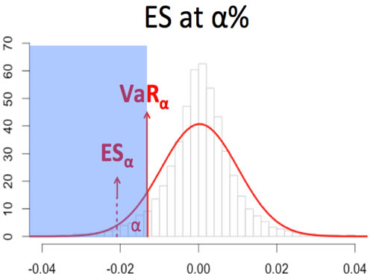
Risk Beyond VaR
Expected Shortfall
The Expected Shortfall (ES) is the average value of the loss that are exceeding the VaR.
So the value of the Expected Shortfall with a probability 𝛼 is
𝐸𝑆_{𝛼}=𝐸(𝑋|𝑋 ≤ 𝑉𝑎𝑅_{𝛼}(𝑋))

Slide 38
Risk Beyond VaR
Expected Shortfall
Average of the losses worse than VaR
ES_{α%, h, t} = E[X| –X ≤ –VaR_{α%, h, t} ]
it is the average loss that occurs in the α% most extreme cases (worst losses)
  e.g., out of 1000 losses, the 5% VaR is the smallest of the 50 largest losses, whilst ES is the average of the 50 largest losses
It is a coherent measure:
ES^{a*P1+b*P2} ≤ a * ES^{P1} + b * ES^{P2}
Also called Conditional VaR or Expected tail loss (ETL)

Slide 39
Comparing VaR and ES
VaR vs ES
Comparison of VaR and ES
VaR is not sub-addictive(coherent measure) for the fat tail distribution, so the diversification advantage will not granted.
 | VaR | ES
Diversification* | No | Yes
Capture Fat tail | No | Yes
Complexity | Less | More
Optimization | Easier | Harder

Slide 40
Reference
Reference
Market Risk , Chapter 2-3, Emese Lazar, ICMA Centre, 2011
Measuring Market Risk, Chapter 2.2, Kevin Dowd, Wiley
US treasury Risk management
https://eiptrading.com/risk-management/
Value at Risk with Monte Carlo Simulation, Samir Khan, N.A.
http://investexcel.net/calculate-value-at-risk-with-monte-carlo-simulation/
Yamai, Yasuhiro, and Toshinao Yoshiba. "Value-at-risk versus expected shortfall: A practical perspective." Journal of Banking & Finance 29.4 (2005): 997-1015.

