Slide 1
FIN4811
Risk Management
Chapter Six
Market risk management
And Hedging
Nattanan Bovornsantisuth

Slide 2
Agenda
What is Hedging?
Hedging FX risk
Hedging Equity risk
Hedging IR risk

Slide 3
Hedging Concept
Definition
Hedging ~ A risk management strategy used in limiting or offsetting probability of loss from fluctuations in the prices of commodities, currencies, or securities.
Hedging is not buying insurance but it is a transferring the risk
  “ Remember, Hedging is not to eliminate the risk”
There are two type of Hedging
  Static Hedging – taking the position for hedging and do not take any further action until the underlying is matured.
  Dynamic Hedging – keep adjusting the size of portfolio to replicate the risk profile of underlying until maturity.

Slide 4
Hedging Concept
Basis risk
Basis risk is defined as the mismatch of the hedging instrument characteristics and underlying asset.
Basis risk will be high when there is cross-hedging.
  EX. US exporter who has an obligation to make a payment of Norwegian Kroner (NKD) could hedge the position by using the future/forward contract of dollar/euro exchange rate. Thus, the basis risk is still exist.
Basis risk will be lower when both hedging instruments asset and the position are corresponded. However, the basis risk still does exist because the maturity will be not matched.
  EX. US exporter who has an obligation to make a payment of Japanese yen (JPY) could hedge the position by using the future/forward contract of dollar/yen exchange rate. However, if the exporters enter the future contract, they might not be able to set the same maturity as the position.

Slide 5
Hedging FX risk
Hedging by Money Market
Hedging by money market is to go to financial market by using the lending or borrowing the foreign currency to cover payables or receivables.
Ex. IBM purchased computer chips from NEC, a Japanese electronics concern, and was billed ¥250 million payable in three months. Currently, the spot exchange rate is ¥105/$ and the three-month forward rate is ¥100/$. The three-month money market interest rate is 2 percent per annum in the U.S. and 1.75 percent per quarter in Japan. The management of IBM decided to use the money market hedge to deal with this yen account payable.

Slide 6
Hedging FX risk
Hedging by Money Market
Cal. PV of underlying
¥250/1.0175 = ¥245.70 m
Pay the Receivables at
¥250 m Yen
Buy Yen spot with USD at the PV amount
¥245.70/105 = $2.34 M
Invest in Japan for 3m
Receive ¥250 m
In the end, IBM will pay 250 million yen at exchange equal to ¥105/$

Slide 7
Hedging FX risk
Hedging by Money Market
Cash Flow table.
In the end, IBM use only -2.34 million dollar for cover receivables.
If there is no hedging, IBM need to use ¥250.00/100 = 2.5 miilion dollar instead.
 | Transaction | CF₀ | CF₁
1 | Buy Yen Spot with Dollar | $-2.34 M
 |  | ¥245.70 M
2 | Invest in Japan | -¥245.70 M | ¥250.00 M
3 | Pay yens |  | ¥-250.00 M
 | Net Cash Flow | $-2.34 M

Slide 8
Hedging instrument
Hedging by using Forward
Forward contracts
  The client can use forward contracts to sell or purchase foreign currency amounts at a future time and a given exchange rate. The settlement takes place at the time and the exchange rate mentioned in the contract, regardless of any fluctuations of the exchange rate on the foreign exchange market
Benefits
  The risk of exchange rate fluctuations is mitigated
  It increases the management’s control over the company’s cash-flows and profitability
  The exchange rate used in budgeting is fixed ex ant
Enter forward contract
Exchange at
contract rate
t₀
t₁

Slide 9
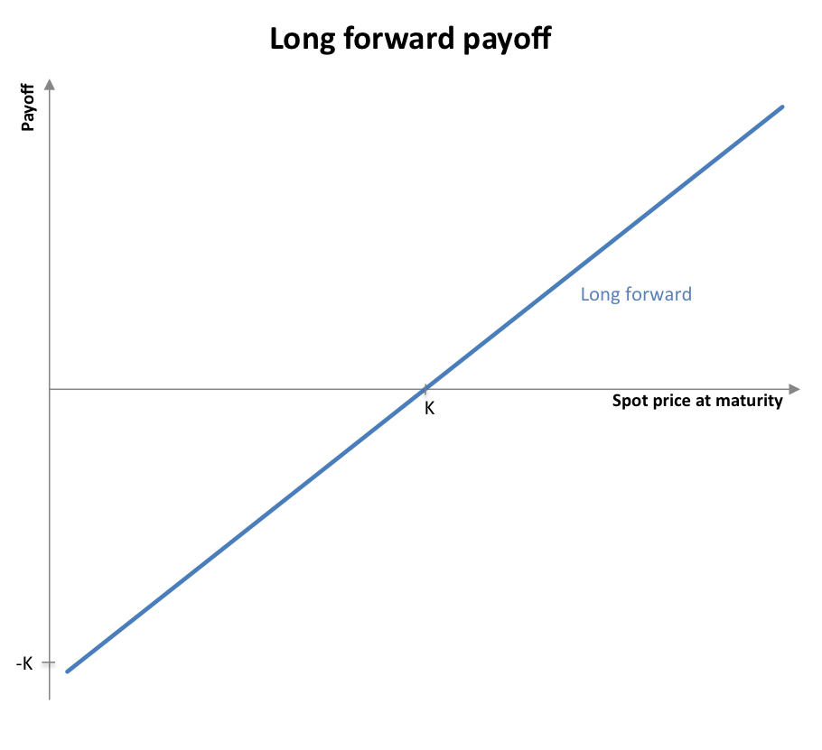
Hedging instrument
FX Forward payoff

Slide 10
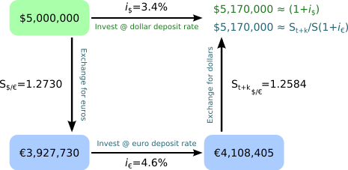
Hedging instrument
Determine Fx forward rate
Interest Rate Parity – Assume the foreign exchange market is equilibrium, the return on domestic asset must equal to the foreign exchange adjusted expected return on foreign currency asset.

Slide 11
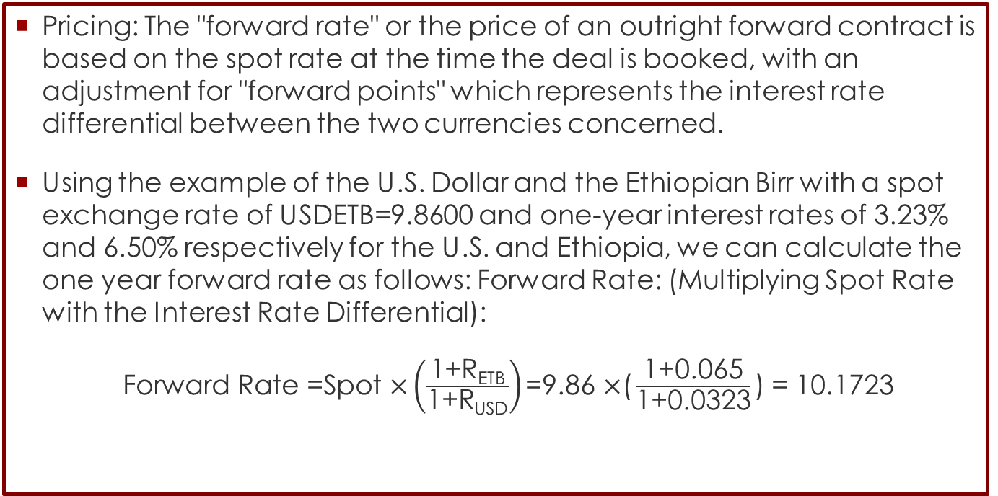
Hedging instrument
Determine Fx forward rate
Pricing: The "forward rate" or the price of an outright forward contract is based on the spot rate at the time the deal is booked, with an adjustment for "forward points" which represents the interest rate differential between the two currencies concerned.
Using the example of the U.S. Dollar and the Ethiopian Birr with a spot exchange rate of USDETB=9.8600 and one-year interest rates of 3.23% and 6.50% respectively for the U.S. and Ethiopia, we can calculate the one year forward rate as follows: Forward Rate: (Multiplying Spot Rate with the Interest Rate Differential):
$\text{Forward} \text{Rate}\text{ =}\text{Spot} \text{×}\left(\frac{\text{1+}\text{RETB}}{\text{1+}\text{RUSD}}\right)\text{=9.86 }\text{×}\text{(}\frac{\text{1+0.065}}{\text{1+0.0323}}\text{)}$ = 10.1723

Slide 12
Hedging instrument
Example
Boeing just signed a contract to sell a Boeing 737 aircraft to Air France. Air France will be billed €20 million which is payable in one year. The current spot exchange rate is $1.05/€. The annual interest rate is 6.0% in the U.S. and 5.0% in France. Boeing is concerned with the volatile exchange rate between the dollar and the euro and would like to hedge exchange exposure.
  What is the actual forward rate according to interest rate parity?
    According to IRP, F = S(1+i$)/(1+i€). Thus the “indifferent” forward rate will be: F = 1.05(1.06)/1.05 = $1.06/€.
  What will Air France gain or loss of the rate at maturity is equal to 1.10 and 1.04?
    If the rate is equal to 1.10 and forward rate in forward contract is equal to 1.06, Air France will gain = (1.10-1.06) * €20 million = € 0.8 million
    At the rate is equal to 1.04 , loss = (1.04-1.06) * €20 million = €-0.4 million

Slide 13
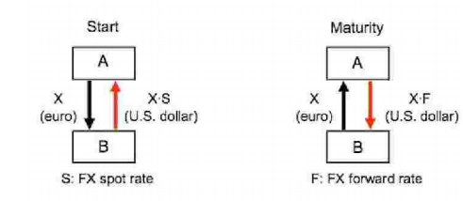
Hedging instrument
FX Swap
FX Swap is the contract between two counterparty which the counterparty will lend the money in one currency and borrow the money in other currencies. Then, Both of them have an obligation to pay back their lending and borrowing in the forward rate.
Source: http://www.sgeb.bg/web/files/richeditor/pdf/en-pdf/fx-swap.pdf

Slide 14
Hedging instrument
Example
Santander bank would like to use funding of euro currency to grant loan on dollar currency for 1 million euro. Santander bank do not want to subject with the exchange rate so Santander bank enter to FX swap contract. The current spot exchange rate is $1.05/€ and the one-year forward rate is $1.10/€. The annual interest rate is 6.0% in the U.S. and 4.0% in Spain.
  What is the actual forward rate according to interest rate parity?
    According to IRP, F = S(1+i$)/(1+i€). Thus the “indifferent” forward rate will be: F = 1.05(1.06)/1.04 = $1.07/€.
  Thus, Santander bank can project the cash flow and lock the exchange and interest rate risk. If this loan pay interest for 7%, the total amount of profit would be: [0.98m+(73,500/1.05)] – 1m = 0.05 million euro.
Enter FX Swap
Santander pay 1m euro
and receive 1.05 m dollar
Santander pay 1.05 m
dollar
and receive 0.98 m euro
t₀
t₂
t₁

Slide 15
Hedging instrument
Hedging using FX option
FX Options give their buyer the right but not the obligation to sell/buy a specific amount at a pre-agreed exchange rate. In order to have this right, the client pays a premium.
An option contract has the same functionality as an insurance contract. The client pays a premium in order to be able to take advantage of its right in case a certain event occurs.
Benefit
  Complete foreign exchange risk hedging
  Better cash-flow and profit management
  Establishing a level for the exchange rate that will be used for constituting the budget of the company
  The possibility to benefit of a favorable exchange rate movement

Slide 16
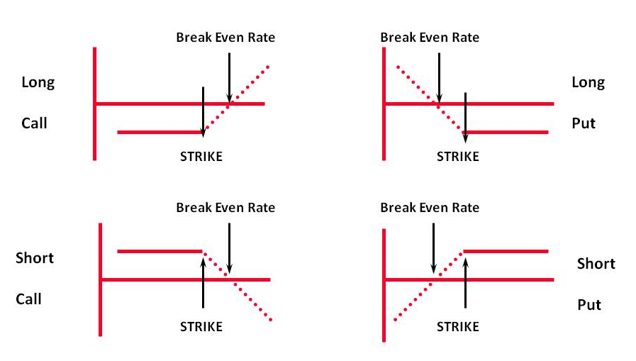
Hedging instrument
Hedging using FX option

Slide 17
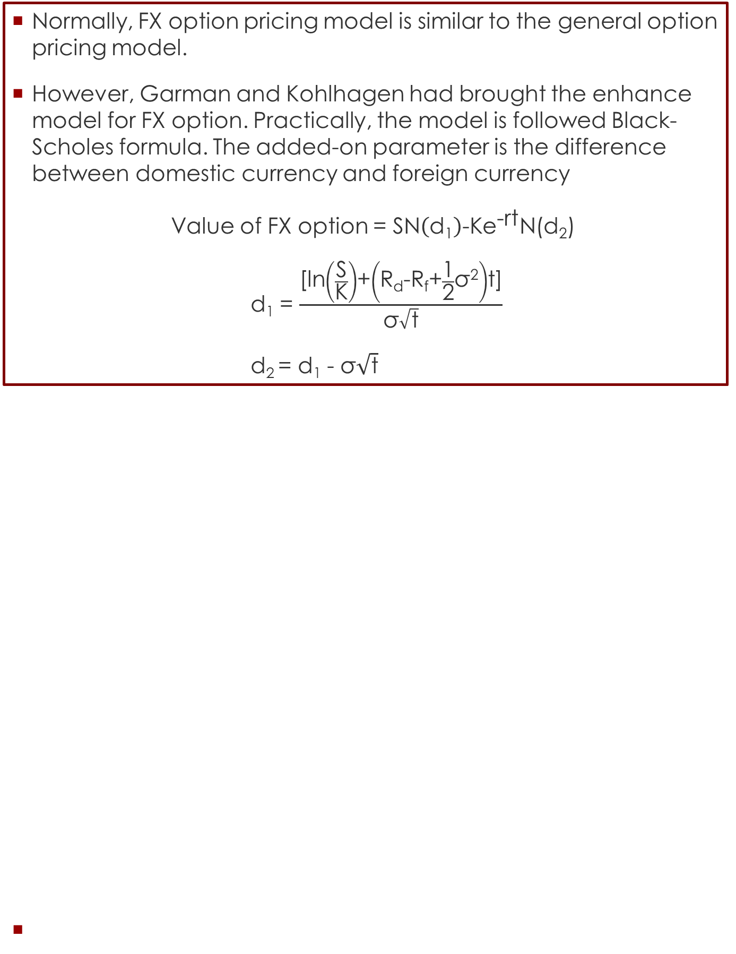
Hedging instrument
Hedging using FX option
Normally, FX option pricing model is similar to the general option pricing model.
However, Garman and Kohlhagen had brought the enhance model for FX option. Practically, the model is followed Black-Scholes formula. The added-on parameter is the difference between domestic currency and foreign currency
Value of FX option = $\text{SN}\left(\text{d}\text{1}\right)\text{−}\text{K}{\text{e}}^{\text{−}\text{rt}}\text{N}\text{(}\text{d}\text{2}\text{)}$
d₁ = $\frac{\text{[}\text{ln}\left(\frac{\text{S}}{\text{K}}\right)\text{+}\left(\text{R}\text{d}\text{−}\text{Rf}\text{+}\frac{\text{1}}{\text{2}}\text{σ}\text{2}\right)\text{t}\text{]}}{\text{σ}\sqrt{\text{t}}}$
d₂ = d₁ - $\text{σ}\sqrt{\text{t}}$

Slide 18
Hedging instrument
Hedging using FX option
B.Lack & S.Choles Enterprises of Salem, OR imports French wine. The wine is really rare, so B.Lack & S.Choles have to bid for the wine. On November 2nd B.Lack & S.Choles bids €62,500, but the firm will not know until December 15th whether the bid is accepted or not. Recently the dollar tanked against the euro, so to protect against a further appreciation of the euro, the firm purchases a €62,500 call option. The strike price is 1.2750 $/€ and the option premium is one cent pr. euro.
If the euro appreciates to 1.3000 $/€, the payment without the option would be $81,250, so B.Lack & S.Choles will exercise the option and purchase the euro for 1.2750, which is a payment of $79,687.5 + premium of $625
If the euro depreciates to 1.2000, B.Lack & S.Choles will be better of buying euro on the spot market, so they let the option expire unused. The payment is then $75,000 + premium of $625

Slide 19
Hedging Interest rate risk
Interest Rate Swaps
The characteristic of swap is two counterparties enter OTC (Over the Counter) contract which one of them has an obligation to pay fix/float and another one has to pay fix/float on the same notional amount and the same period.
The most common interest rate used for underlying is “LIBOR”
LIBOR is from “London Interbank Offered Rate” which is the rate prepared by banks for other banks loan in short term (up to 12 month)
Fix leg
Counterparty A
Counterparty B
Float leg

Slide 20
Hedging Interest rate risk
Using Swap to transform the liability
Company A has a loan from a bank at LIBOR rate + 4%.
Company A wants to hedge the fluctuation of Interest rate by enter the Interest Rate Swap by paying the fix rate at 5%
The cash flow of Company A would be
Fix rate : 5%
Floating rate : Libor+4%

Slide 21
Hedging Interest rate risk
Using Swap to transform the asset
Once Company A have invested in Bond for €100 million which provide coupon at 4.7% per annum.
Company A can transform the interest rate to be a floating rate by enter the swap contract.
LIBOR
4.7%
Counterparty A
Counterparty B
LIBOR - 0. 2%
5%
Counterparty A will receive interest at LIBOR-0.3% instead of 4.7%
Counterparty B will receive interest at 4.8% instead of LIBOR -0.2%

Slide 22
Hedging Interest rate risk
Cross Currency Rate Swaps
Normally, the characteristic of Currency swap will be the same as IRS swap, but the differences are Currency swap incorporates the exchange of principal amount and interest rate in one currency and other principal amount and interest rate in another currency
It could be fixed for fixed contract, fixed for float contract or float for float contract.
The make use of this product is similar to IRS Swap.
Dollar %
Counterparty A
Counterparty B
Sterling %

Slide 23
Hedging Interest rate risk
Cross Currency Rate Swaps
A UK company needs to borrow £50m for three years to build a new factory. With market interest rates lower in the US, it finds it cheaper to raise $75m in the US and then swap into sterling. This swap will allow the company to service the interest payments on the loan in sterling, before swapping the principal back so that it can be repaid at the maturity of the loan in three years time.
Received: £50 GBP
Received: $75 USD
Floating rate : USD
Pay: $75 USD
Floating rate : GBP
Pay: £50 GBP

Slide 24
Hedging Interest rate risk
Valuation of Swap: Bond Valuation
The principal amount of the contract might not be able to exchange before the maturity. In order to valuation of swap, we assume that we take long position of fix rate and take short position of floating rate and vice versa.
The formula will be
V_{swap} = B_{fix} - B_{float}
Denoted
V_{swap} = Value of swap contract
B_{fix} = Valuation by bond pricing of fix leg
B_{float} = Valuation by bond pricing of float leg

Slide 25


Hedging Interest rate risk
Valuation of Swap
Valuation of Swap: Bond Valuation
For example, a three-year IRS contract which notional amount is equal to $100 million has the characteristic of fixed rate 4.0% against 6-month LIBOR rate plus 20 bps. The residual maturity of this contract is 1.25 years (15 months). The LIBOR rates matured in 6 months, 12 months, and 18 months are 10%, 10.5%,11% respectively. The rate of 6-month LIBOR plus 20 bps at the last payment is 10.2%
Therefore, the value of swap is 95.587 – 99.974 = -4.38705
K = 100 x 10.2% x 0.5 = 5.1
CF = 100 + 5.1 = 105.1
PV = 105.1x $\text{−}{\text{e}}^{\text{−10\%∗}\text{0.5}}$
$${\text{e}}^{\text{−10\%∗}\text{0.5}}$$
Time | B_{fix} | B_{float} | DF | PV of B_{fix} | PV of B_{float}
6 months | 4.0 | 105.10 | 0.9512 | 3.805 | 99.974
12 months | 4.0 |  | 0.9003 | 3.601
18 months | 104.0 |  | 0.8478 | 88.181
Total |  |  |  | 95.587 | 99.974
Notes:
The floating-rate bond can therefore be regarded as an instrument providing a single cash flow.

Slide 26
Hedging Interest rate risk
Valuation of Swap: FRA Valuation
Swap and FRA can share the common characteristic. The first exchange rate will be known. However, the rest of the exchange are unknown yet. Thus, we can regard them as five FRA.
Under the assumption that the forward rate can be realized, the step for valuation SWAP is:
  Apply LIBOR/SWAP zero curve in order to build the forward rate for all cash flows.
  Compute each cash flow by assuming that the LIBOR rates will equal to Forward rate.
  Find PV of each cash flow using the LIBOR/SWAP zero curve .

Slide 27
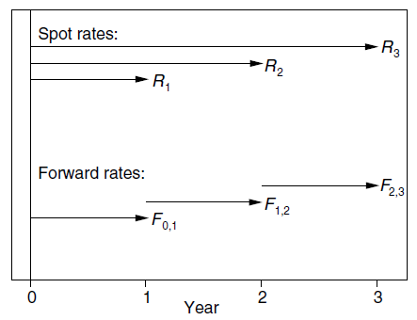
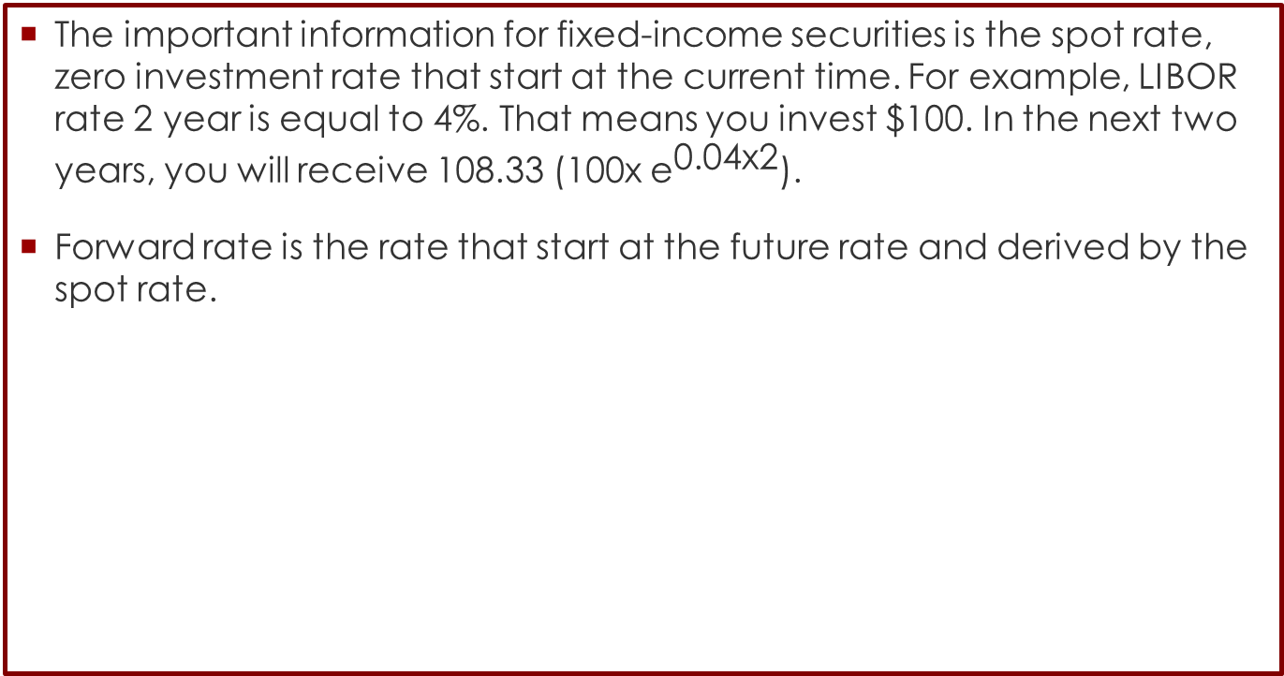
Hedging Interest rate risk
Forward Rate
The important information for fixed-income securities is the spot rate, zero investment rate that start at the current time. For example, LIBOR rate 2 year is equal to 4%. That means you invest $100. In the next two years, you will receive 108.33 (100x ${\text{e}}^{\text{0.04}\text{x}\text{2}}$).
Forward rate is the rate that start at the future rate and derived by the spot rate.

Slide 28
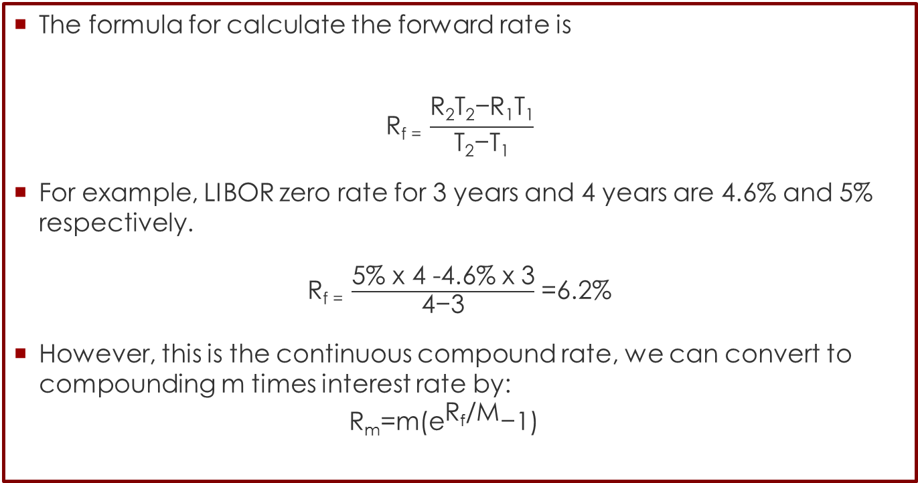
Hedging Interest rate risk
Forward Rate
The formula for calculate the forward rate is
$$\text{R}\text{f}\text{ = }\frac{\text{R}\text{2}\text{T}\text{2}\text{−}\text{R}\text{1}\text{T}\text{1}}{\text{T}\text{2}\text{−}\text{T}\text{1}}$$
For example, LIBOR zero rate for 3 years and 4 years are 4.6% and 5% respectively.
$\text{R}\text{f}\text{ = }\frac{\text{5\% }\text{x}\text{ 4 −4.6\% }\text{x}\text{ 3}}{\text{4}\text{−}\text{3}}$ =6.2%
However, this is the continuous compound rate, we can convert to compounding m times interest rate by:
$\text{R}\text{m}\text{=}\text{m}\text{(}{\text{e}}^{\text{R}\text{f}\text{/}\text{M}}\text{−1) }$

Slide 29
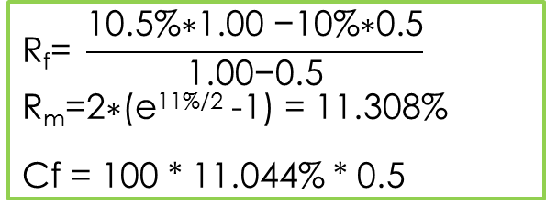
Hedging Interest rate risk
Forward Rate
For example, a three-year IRS contract which notional amount is equal to $100 million has the characteristic of fixed rate 4.0% against 6-month LIBOR rate plus 20 bps. The residual maturity of this contract is 1.25 years (15 months). The LIBOR rates matured in 6 months, 12 months, and 18 months are 10%, 10.5%,11% respectively. The rate of 6-month LIBOR plus 20 bps at the last payment is 10.2%
$$\text{R}\text{f}\text{= }\frac{\text{10.5\%∗}\text{1.00}\text{ −10\%∗0.}\text{5}}{\text{1.00}\text{−}\text{0.5}}$$
$\text{R}\text{m}\text{=}\text{2∗(}\text{e}\text{11}\text{\%/2}$ -1) = 11.308%
Cf = 100 * 11.044% * 0.5
Time | B_{fix} | B_{float} | Net CF | DF | PV of B_{float}
6 months | 4.0 | -5.100 | -1.100 | 0.9512 | -1.046
12 months | 4.0 | -5.650 | -1.654 | 0.9003 | -1.489
18 months | 104.0 | -106.184 | -2.184 | 0.8478 | -1.851
Total |  |  |  |  | -4.387

Slide 30
Hedging Strategy
Stock index futures
Based on stock market indices: FTSE 100, Nikkei 225, S&P 500, SET
etc.
  Index chosen by exchange as part of contract design.
  Underlying asset is not physically traded.
Offer a way of:
  Trading/speculating on future movements of the market.
  Hedging the systematic risk of a portfolio.
Beta is close to 1, that is, spot and futures prices move together,
except for very short hedges (basis risk).

Slide 31
Hedging Strategy
Stock index futures
Contract size is determined as index level Χ contract multiplier.
  Index level is under no particular currency. It is meaningful only if compared to the past values of the same index. Example: On 14th Nov 07, FTSE 100 closed at 6,432.10 and 3
  months before it closed at 6,143.50, so it moved up by 4.7%.
  Multiplier/multiple is arbitrary value per index point defined by the exchange
  Example: London uses £ 10 per index point, so if futures price of FTSE 100 is at 5,000, then the notional value of the contract is £50,000.
Almost always cash-settled:
  Parties exchange the cash difference between the asset’s notional value now and at point of agreement.
  Physical settlement is very inconvenient as delivery of basket of shares is required and this is expensive to trade.

Slide 32
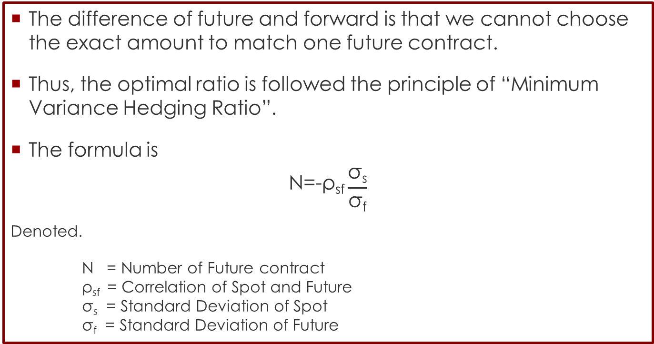
Hedging Concept
Optimal Hedging Ratio
The difference of future and forward is that we cannot choose the exact amount to match one future contract.
Thus, the optimal ratio is followed the principle of “Minimum Variance Hedging Ratio”.
The formula is
$$\text{N}\text{=}\text{−}\text{ρ}\text{sf}\frac{\text{σ}\text{s}}{\text{σ}\text{f}}$$
Denoted.
N = Number of Future contract $\text{ρ}\text{sf}$ = Correlation of Spot and Future $\text{σ}\text{s}$ = Standard Deviation of Spot $\text{σ}\text{f}$ = Standard Deviation of Future

Slide 33

Hedging Strategy
Hedging with index futures
If we need hedge for one month, we should:
  Regress the portfolio monthly returns (from simulation with the current allocation) against the index monthly returns to find the beta of the portfolio:
  Then sell $\text{β}\frac{\text{portfolio} \text{value}}{\text{contract} \text{size}}$ futures contracts with expiry in one month.
  If the one-month contract is not available, sell contract with expiry greater than 1 month and close it (buy it back) after 1 month. This will introduce some basis risk in the hedge.
  We assume the index has beta = 1 with its futures price.
$$\text{R}\text{p}\text{,}\text{t}\text{= }\text{α}\text{+ }\text{βRI}\text{,}\text{T}\text{+}\text{ut}\text{ ⇒ }\text{β}\text{= }\frac{\text{Cov}\text{(}\text{Rp}\text{,}\text{t}\text{,}\text{Ri}\text{,}\text{t}\text{)}}{\text{Var}\text{(}\text{Ri}\text{,}\text{t}\text{)}}$$

Slide 34
Hedging Strategy
Reference
Jorion, P. Financial Risk Manager Handbook, 4th Edition.
Hull, J. (2006). Options, futures, and other derivatives. Upper Saddle River, N.J: Pearson/Prentice Hall.
http://treasurytoday.com/2002/09/managing-foreign-exchange-risk-the-use-of-currency-swaps

