Slide 1
FIN4811
Risk Management
Chapter Eight
Credit Risk
Nattanan Bovornsantisuth

Slide 2
Agenda
  Definition
  Credit Loss Distribution
  Expected Loss
    Probability of Default
    Loss Given Default
    Exposure at Default

Slide 3
Credit Risk
Definition
Credit risk may be defined as the financial loss suffered due to the default of a borrower or counterparty under a contract.
Banks describe credit risk as the risk that customers
default, that is, fail to comply with their obligations to service debt.
Credit risk for professional consultancies such as solicitors, architects or town planners is where customers default on payment of invoices.
Manufacturers who sell goods on credit face the risk that the customer may not ultimately pay.

Slide 4
Credit Risk
Definition
The amount at risk, the outstanding balance at the date of default, differs from the total potential loss in the event of default, due to the potential recoveries.
The recoveries depend upon any credit risk mitigations, such as
guarantees (collateral or third party), the capability of negotiating with the borrower and the funds available (if any) to repay the debt after repayment of other lenders.
As a consequence, credit risk may be said to have three main components: Probability of default, exposure and recovery.

Slide 5
Credit Risk
Default
There are several definitions of “default”
  Payment default is declared when a scheduled payment has not been made for a minimum period, such as three months after the due date.
  Breaking a covenant occurs when fixed upper and lower bounds of a financial ratio are not adhered to, and this is recognised as a
  technical default.
An economic default occurs when the economic value of assets goes below the value of the outstanding debts.
If the market value of assets drops below that of liabilities,
it means that the current expectations of future cash flows are such that the debt cannot be repaid.

Slide 6
Credit Risk
Default
Default is measured by the probability that default occurs during a given period of time (called Probability of Default, denoted as PD)
Default depends upon the credit standing of a borrower. Such credit standing depends on several factors such as market outlook, the size of the company, its competitive context, the
quality of management and the shareholders.
Historical statistics can and are used by such organisations as banks. From the statistical records of observed defaults the ratio of defaults in a given period over the total sample of borrowers can be derived. It is a default rate which often serves as a historical proxy for default probability.

Slide 7
Credit Risk
Credit Loss Distribution
Vasicek’s Model is the most widely used in banking industry and in Basel II regulation for Internal Rated Base Approach method(IRB) for credit risk capital calculation.
The key assumption
  homogeneous portfolio (equal investment in each credit)
    equal dollar amount
    equal probability of default p
    flat correlation coefficient ρ between the asset values of any two companies
    the same term T
  very large number of credits

Slide 8
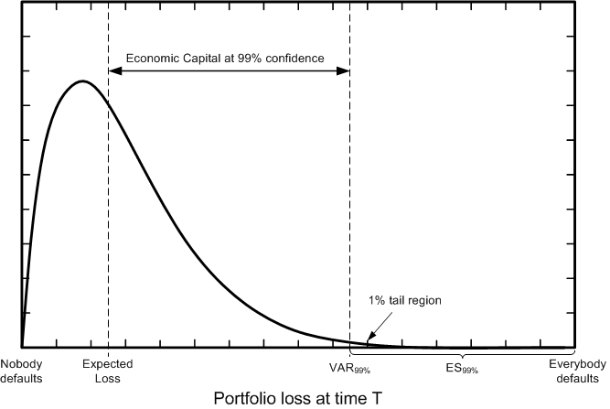
Credit Risk
Credit Loss Distribution

Slide 9
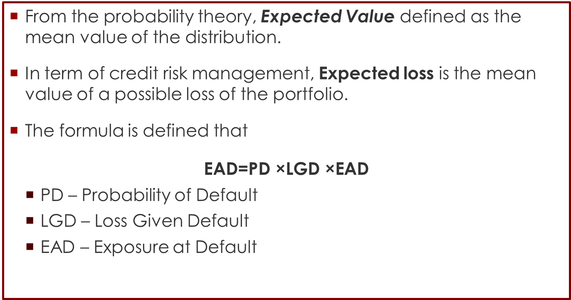
Credit Risk
Expected Loss
From the probability theory, Expected Value defined as the mean value of the distribution.
In term of credit risk management, Expected loss is the mean value of a possible loss of the portfolio.
The formula is defined that
$$\text{EAD}\text{=}\text{PD}\text{ ×}\text{LGD}\text{ ×}\text{EAD}$$
  PD – Probability of Default
  LGD – Loss Given Default
  EAD – Exposure at Default

Slide 10
Credit Risk
Probability of Default
Probability of Default (PD) is the likelihood that counterparty will be unable to pay back debt or face with the credit events.
The conditional probability is the probability of default for a certain time period conditional on no earlier default
The unconditional default probability is the probability of default for a certain time period as seen at time zero
There are several way to estimate PD for example
  Actuarial Method – Using historical default data and its own financial characteristic such as Altman Z-score and Credit Scoring card
  Market Price Method – PD will be inferred for traded price or credit derivative “risk-neutral” such as KMV model

Slide 11
Credit Risk
Credit Rating
Credit ratings is to evaluate of the creditworthiness given by rating agency such as Moody, Standard and Poor, and Fitch.
Generally, the interpretation of rating is implied the Probability of Default.
The rating agency will use the ratio from the account of financial statement to assign the rating.
Rating will be classified into two level which are
  Investment Grade
  Speculative Grade

Slide 12
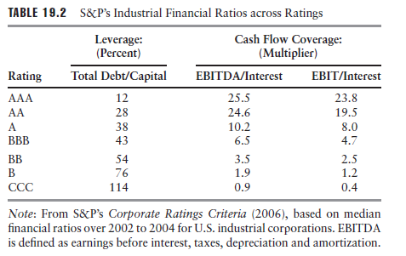
Credit Risk
Credit rating

Slide 13
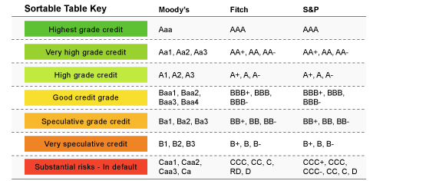
Credit Risk
Credit Rating
Source http://www.wsj.com/articles/SB10001424052970203914304576630742911364206

Slide 14
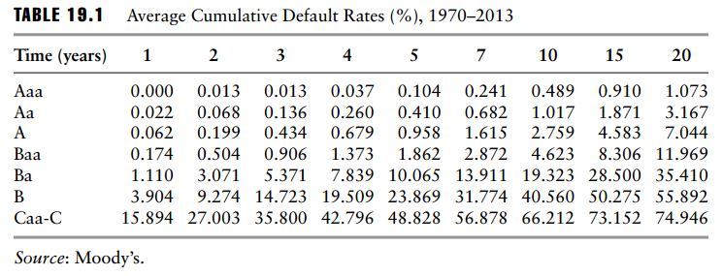
Credit Risk
HISTORICAL DEFAULT PROBABILITIES
Historical Default probability is typical of the data that is produced by rating agencies. It shows the default experience through time of companies that started with a certain credit rating.

Slide 15
Credit Risk
HISTORICAL DEFAULT PROBABILITIES
For example, Table 19.1 shows that a bond with an initial Moody’s credit rating of Baa has a 0.174% chance of defaulting by the end of the first year, a 0.504% chance of defaulting by the end of the second year, and so on.
The probability of a bond defaulting during a particular year can be calculated from the table. For example, the probability that a bond initially rated Baa will default during the second year of its life is 0.504 − 0.174 = 0.330%.
Table 19.1 shows that, for investment grade bonds, the probability of default in a year tends to be an increasing function of time. This is because the bond issuer is initially considered to be creditworthy and the more time that elapses, the greater the possibility that its financial health will decline.

Slide 16
Credit Risk
Conditional Probability of Default
Normally, unconditional PD will be defined as how much chance of the firm is to be default within the given period of time.
On the other hands, conditional PD will find the probability the firm can survive until the time T. The default will happen at least at time T.
In order to do that we apply Survival Analysis to find the conditional probability .
There are two main functions that have been used.
  Survival Function
  Hazard Rate

Slide 17
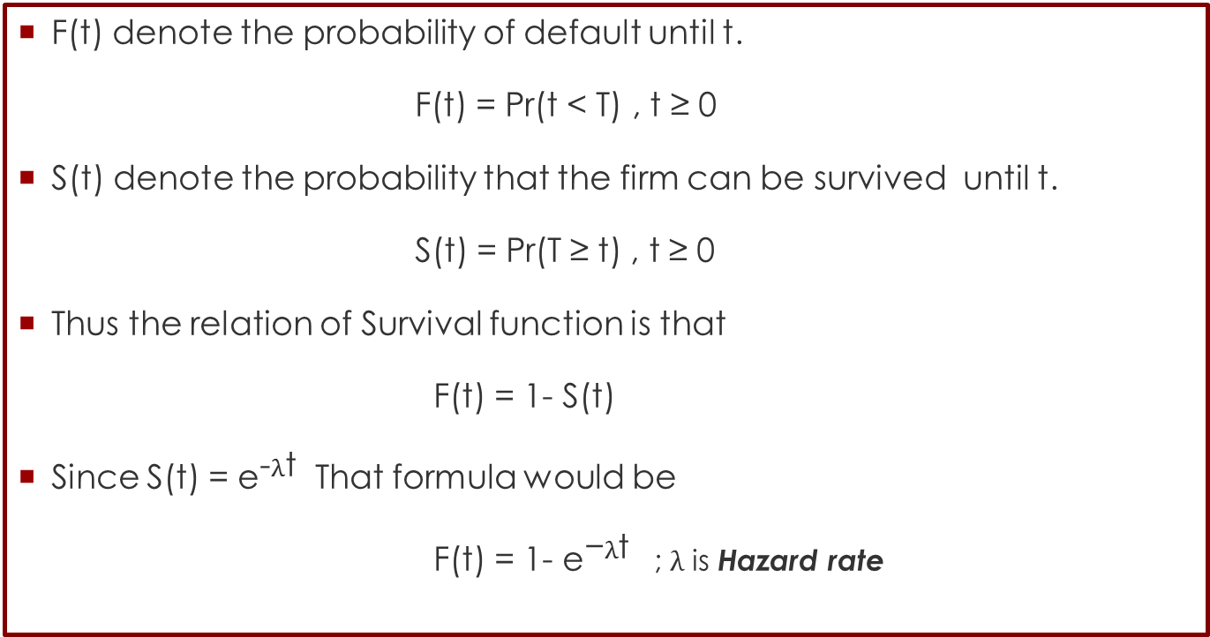
Credit Risk
Survival Function
F(t) denote the probability of default until t.
F(t) = Pr(t < T) , t ≥ 0
S(t) denote the probability that the firm can be survived until t.
S(t) = Pr(T ≥ t) , t ≥ 0
Thus the relation of Survival function is that
F(t) = 1- S(t)
Since S(t) = ${\text{e}}^{\text{−}λ\text{t}}$ That formula would be
F(t) = 1- ${\text{e}}^{\text{−}λ\text{t}}$ ; $λ$ is Hazard rate

Slide 18
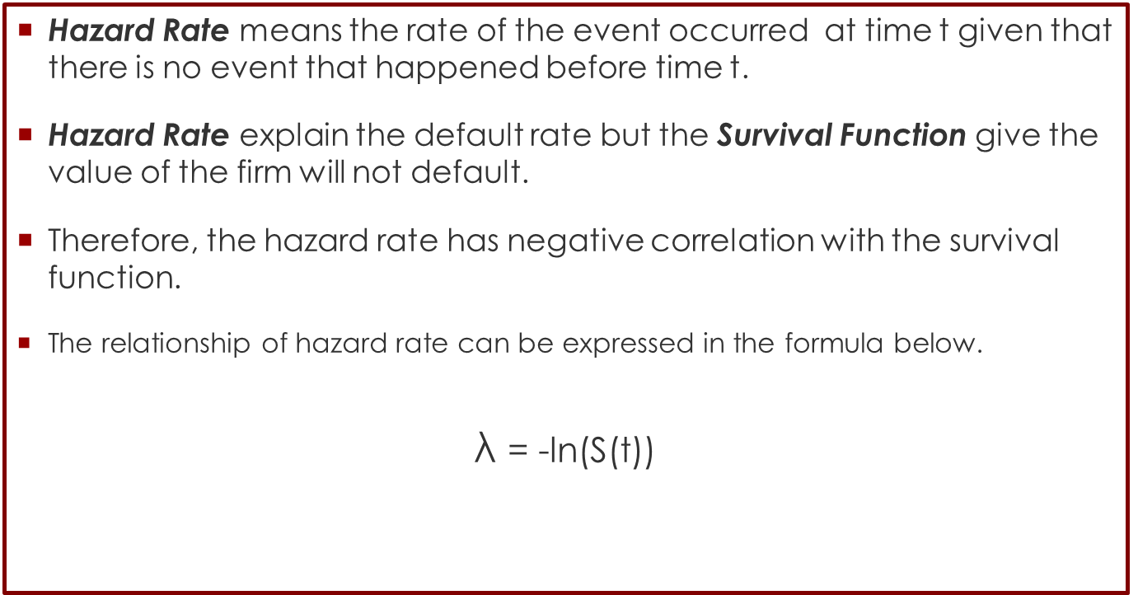
Credit Risk
Hazard Rate
Hazard Rate means the rate of the event occurred at time t given that there is no event that happened before time t.
Hazard Rate explain the default rate but the Survival Function give the value of the firm will not default.
Therefore, the hazard rate has negative correlation with the survival function.
The relationship of hazard rate can be expressed in the formula below.
$$\text{λ} \text{=}\text{ −}\text{ln}\text{(}\text{S}\text{(}\text{t}\text{))}$$

Slide 19
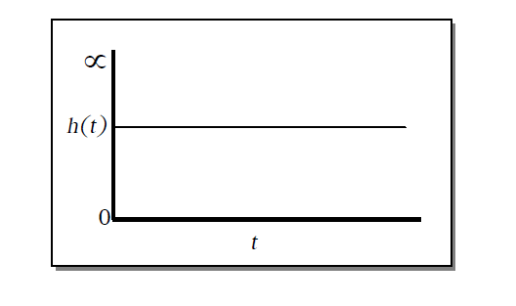
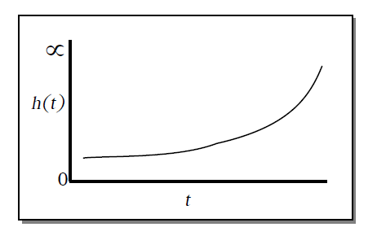
Credit Risk
Hazard Rate
Hazard Rate can be explain in a graph under the various assumption.
Exponential
Increasing Weibull

Slide 20
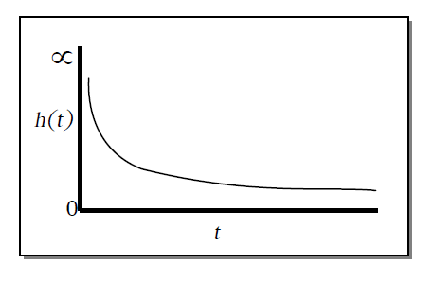
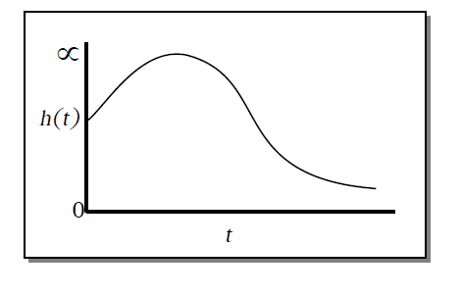
Credit Risk
Hazard Rate
Hazard Rate can be explain in a graph under the various assumption.
Decreasing Weibull
Log normal

Slide 21
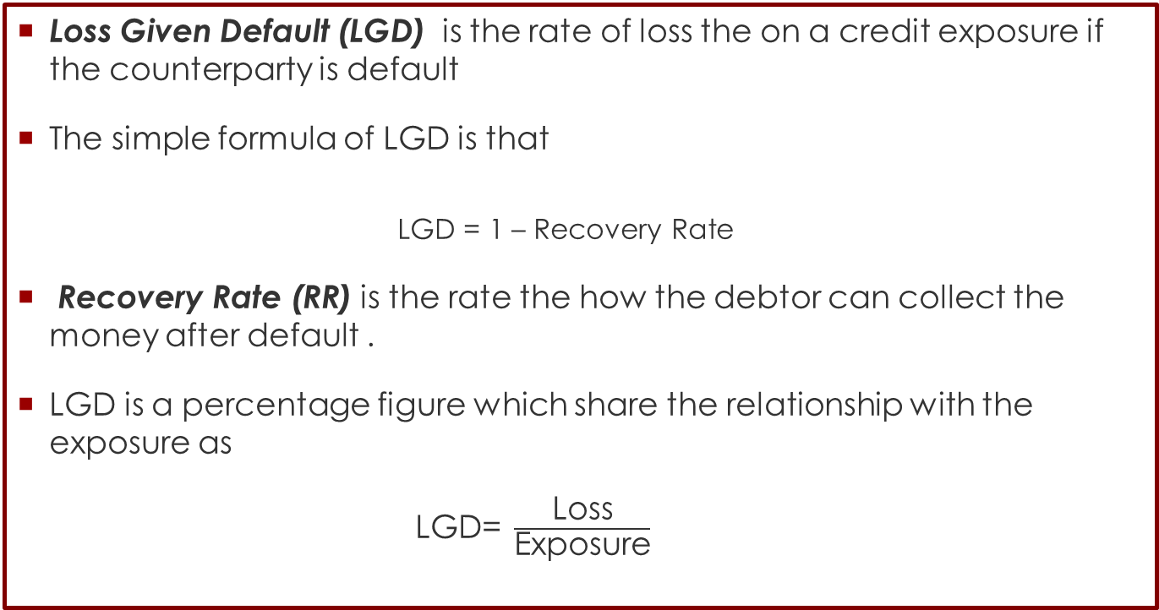
Credit Risk
Loss Given Default
Loss Given Default (LGD) is the rate of loss the on a credit exposure if the counterparty is default
The simple formula of LGD is that
    LGD = 1 – Recovery Rate
Recovery Rate (RR) is the rate the how the debtor can collect the money after default .
LGD is a percentage figure which share the relationship with the exposure as
$\text{LGD}\text{=} \frac{\text{Loss}}{\text{Exposure}}$

Slide 22
Credit Risk
Loss Given Default
Once a default event has occurred, loss given default includes three types of losses:
  The loss of principal
  The carrying costs of non-performing loans, e.g. interest income foregone
  Workout expenses (collections, legal, etc.)
There are several way to measure LGD:
Market LGD - Observed from market prices of defaulted bonds or marketable loans soon after the actual default event.
Workout LGD - The set of estimated cash flows resulting from the workout and/or collections process, properly discounted, and the estimated exposure
Implied Market LGD - LGDs derived from risky (but not defaulted) bond prices using a theoretical asset pricing model.

Slide 23
Credit Risk
Market LGD
Market LGD would be employs the price of bond after default as a proxy of the recovered amount.
Post-default price is available only for the fraction of the debt that is traded and for which after-default market exists – very often they are available only for corporate bonds issued by large companies.
Market LGD is therefore highly limited for defaulted bank loans that are traditionally not traded. For them one must turn to the other approach.
In the Moody’s dataset, for example, they are observed in the market one month after the first occurrence of the default event.
This price is therefore the market’s expected present value of eventual recovery.

Slide 24
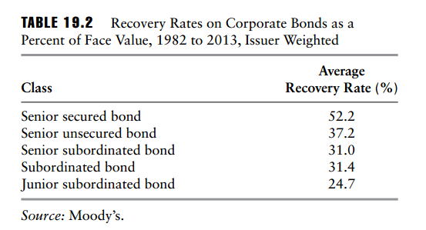
Credit Risk
Market LGD
Moodys’ provides historical data on average recovery rates for different categories of bonds in the United States. This varies from 52.2% for those that are both senior to other lenders and secured to 24.7% for those that rank after other lenders.

Slide 25
Credit Risk
Workout LGD
Workout LGD considers all relevant facts that may influence the final economic value of the recovered part of the exposure arising in the long-running workout process.
The main factors that contribute LGD are seniority, collateral types, cash flow from distressed asset , time for liquidation, and financial ratios of the firm.
Sometimes, the claims from bankruptcy are not always cash, so there would be some complication when the claims are securities.
There are two basic way to estimate workout LGD:
  Discounted cash flow of the claims
  Using the historical data,

Slide 26
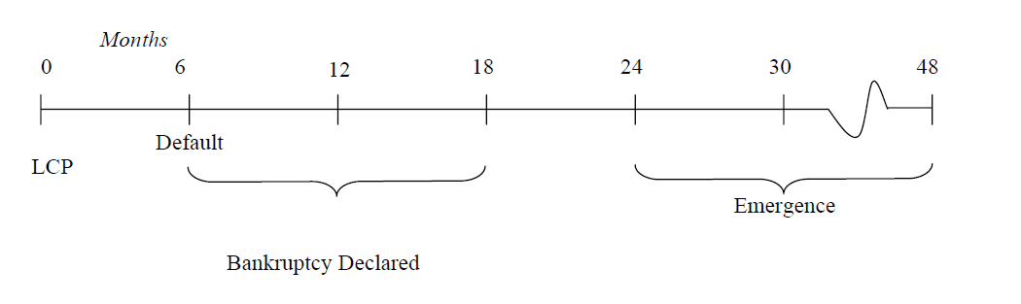
Credit Risk
Anatomy of a Bankruptcy
In reality, the bankruptcy did not cause all losses because every loan must have a collateral or even loans do not have collateral, the debtor can sue the firm to liquidate all assets to pay back debt.
Let discuss the timeline of
The longer of the process, the higher value of LGD.

Slide 27
Credit Risk
Historical data
Mostly, LGD will reflect the real case when the debtors handle with the bankruptcy.
However, it would take time and value of LGD will be various due to the different scenarios.
Another way to model LGD from the historical data is do the regression analysis such as single factor model method
Beginning with setting LGD as a dependent variable.
The independent variables would be the factors the might effect on LGD such as macro economic variables, seniority of claim, and individual factors.

Slide 28
Credit Risk
For example
According to Radovan CHALUPKA and Juraj KOPECSNI (2009), they do the regression by using the characteristic of the collateral, debt and borrower to find LGD of Bank Loan LGD of Corporate and SME Segments:
Then, they categorize the type of loans
  Class A: low risk – cash, land and residential real estate
  Class B: lower average risk – movables and receivables
  Class C: upper average risk – commercial real estate
  Class D: high risk – securities and guarantees
Moreover, they still categorize the type of firms according to the industries.
  New industrial ex. Financial Services, Life Sciences, IT and Healthcare
  Traditional industrial

Slide 29
Credit Risk
For example
The independent variable can classified into three types:
  Counterparty related factors: industry classification, the company’s age at the time of default, year of default, year of company origination, year of loan origination and length of business connection at the time of default.
  Contract related factors: type of the contract, exposure at the time of default, interest rate on the loan, tenure and number of different type of contracts.
  Collateral related factors: collateral type, collateral value by type, aggregate collateral value, collateral value relative to the EAD, collateral value as a percentage of aggregate collateral value, a number of collaterals and diversification as a number of different collaterals.

Slide 30
Credit Risk
Implied Market LGD
Implied Market LGD is estimated ex-ante from market prices of non-defaulted loans, bonds, or credit default instruments by structural or reduced-form models.
The idea is that prices of risky instruments reflect market’s expectation of the loss and may be broken down into PD and LGD.
Implied market LGD estimation does not rely on historical data and can be especially used for low default facilities, for which is an insufficient historical database with experienced LGD.
Each risky asset should offer an expected return corresponding to its degree of risk; therefore all risky parameters must be evaluated by market in order to get the equilibrium price.
Thus, we can extract the key risk parameters, PD and LGD, from prices

Slide 31
Credit Risk
Exposure at Default
Exposure at Default (EAD), unlike PD and LGD, is a whole amount of money that has potential loss if the counterparty default.
EAD is calculated differently according to the type of instruments For example,
  Loan – EAD is equal to the principle plus the remaining interests
  Bond – EAD is Outstanding amount (Face value) with the accrual interests
      EAD = Outstanding + Interest
  Equity – EAD is the market value of the stocks
However, for complex instruments that the exposure is not stable such as derivatives. EAD calculation will be not simple.

Slide 32
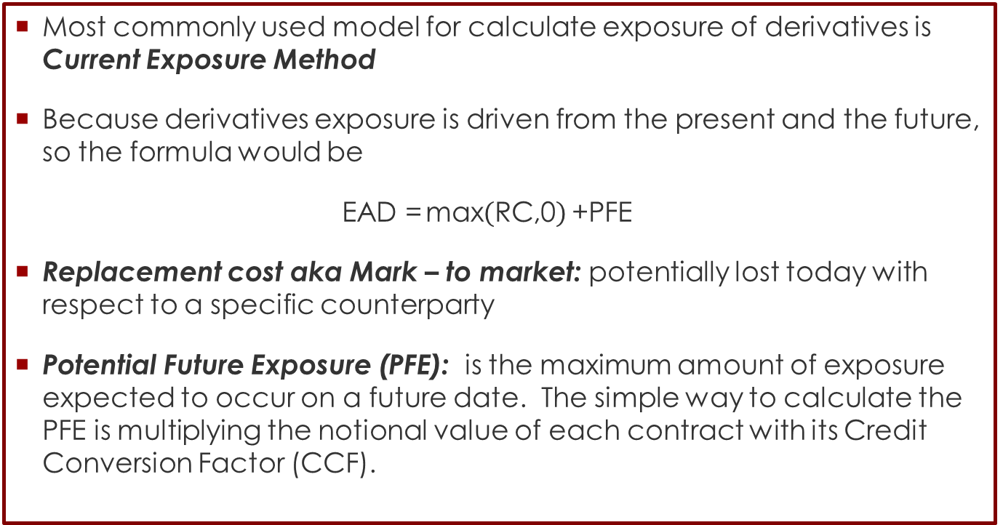
Credit Risk
Current Exposure Method
Most commonly used model for calculate exposure of derivatives is Current Exposure Method
Because derivatives exposure is driven from the present and the future, so the formula would be
$\text{EAD}\text{ =}\text{max}\left(\text{RC}\text{,0}\right)\text{+}\text{PFE}$
Replacement cost aka Mark – to market: potentially lost today with respect to a specific counterparty
Potential Future Exposure (PFE): is the maximum amount of exposure expected to occur on a future date. The simple way to calculate the PFE is multiplying the notional value of each contract with its Credit Conversion Factor (CCF).

Slide 33

Credit Risk
Potential Future Exposure
There are plenty of way to calculate PFE.
The most popular and easiest method is
$\text{PFE}\text{ = }\text{Notional} \text{Amount} ×\text{ad}{\text{d}}_{\text{on}} \text{factor}$
Add_{on} factor is estimated by Basel Committee to calculate PFE. It depends on the maturity and the type of underlying asset.
PFE Add-on Factors
Maturity | IR | FX | Equity | Commoditiy
≤ 1 year | 0% | 1% | 6% | 10%
>1 year and ≤5 years | 0.50% | 5% | 8% | 12%
> 5 years | 1.50% | 7.50% | 10% | 15%

Slide 34
Exercise
Example
Company A has two derivative contracts with Bank B and the detail is below.
What is the total EAD?
 | Forward Contract | Interest Rate Swap
Mark-to-market | -50,000 USD | 100,000 USD
Notional | 1,000,000 USD | 200,000,000 USD
Residual Maturity | 1 month | 2 years

Slide 35
Credit Risk
Current Exposure Method
EAD of forward would be
EAD = Max(0,-50,0000) + (1,000,000 x 1%)
= 10,000 USD
EAD of IRS would be
EAD = Max(0,100,0000) + (200,000,000 x 1%)
= 100,000 + 1,000,000 USD
= 1,100,000 USD
Total EAD would be 1,110,000 USD

Slide 36
Credit Risk
Example
There are plenty of way to calculate PFE.
The most popular and easiest method is
$\text{PFE}\text{ = }\text{Notional} \text{Amount} ×\text{ad}{\text{d}}_{\text{on}} \text{factor}$
Add_{on} factor is estimated by Basel Committee to calculate PFE. It depends on the maturity and the type of underlying asset.

Slide 37
Credit Risk
Reference
Jorion, P. Financial Risk Manager Handbook, 4th Edition.
Hull, J. (2006). Options, futures, and other derivatives. Upper Saddle River, N.J: Pearson/Prentice Hall.
Kotzé, Antonie, and Paul Du Preez. "Current exposure method for CCPs under Basel III." Risk Governance & Control: Finan-cial Markets & Institutions 3 (2013): 7-17.
Schuermann, Til. "What do we know about Loss Given Default?." (2004).
Chalupka, Radovan, and Juraj Kopecsni. "Modeling bank loan LGD of corporate and SME segments: a case study." Czech Journal of Economics and Finance59.4 (2009): 360-382.
Seidler, Jakub, and P. Jakubík. Implied Market Loss Given Default: structural-model approach. No. 2008/26. Charles University Prague, Faculty of Social Sciences, Institute of Economic Studies, 2008.

Slide 38
Credit Risk
Reference
García-Céspedes, Rubén, and Manuel Moreno. "Probability of Default Uncertainty in the Vasicek Credit Risk Framework." Available at SSRN 2761013 (2016).

