Slide 1
FIN4811
Risk Management
Chapter Ten
Credit Risk Mitigation &
Hedging Instruments
Nattanan Bovornsantisuth

Slide 2
Agenda
  Credit Risk Mitigation
    Discounted Account Receivables
    Guaranteed
    Collateral
  Hedging Instrument
    Credit Default Swap
    Credit Linked Note
    Structured Credit Products

Slide 3
Credit Risk Mitigation
Discounted Account Receivables
Normally, firms will give the credit to the counterparty for a term payment. This is called “Account Receivables”.
However, firms have to take the credit risk in the exchange of premium from the counterparty.
Discounted Account Receivables means
“Invoices that are outstanding and typically represent money that is owed to a company's creditors. The creditor who is owed money can sell these invoices to a buyer for an amount that is less than their face value and helps the creditor in recouping at least some of the funds that are owed to them”
Source: http://www.investorwords.com/16898/accounts_Receivables_Discounteded.html

Slide 4
Credit Risk Mitigation
Discounted Account Receivables
Accounts Receivables are often sold at a Discounted in order to mitigate the risk that the debtor will not satisfy the obligation.
The buying firm - also referred to as a "factor" - purchases the financial obligation at a Discounted rate providing the selling firm with immediate cash.
There are two types of Discounted account Receivables
  With Recourse - recourse factoring allows the Factor to come back to the Seller for payment. The risk of insolvency does not transfer to the Factor when an invoice is purchased. If a customer refuses or is unable to pay the invoice (due to bankruptcy).
  Without Recourse - With Non Recourse factoring the risk of insolvency and non-payment is completely transferred to the Factoring company. If the customer goes bankrupt or refuses to pay the invoice (for whatever reason), the Factor cannot come back to the Seller for payment.

Slide 5
Credit Risk Mitigation
Guaranteed
Another credit risk mitigation is to allow the firm that has the lower credit risk to guarantee payments or debts.
Firm can fully claim the responsibility of payment/debt.
Thus, PD of guarantors will substitute the PD of debtors in order to calculate the expected loss
Expected loss = EAD x PD x (1-RR)
PD will be the PD of guarantors instead

Slide 6
Credit Risk Mitigation
Double Default
In this case, lenders’ expected loss is not getting full benefits from guarantee.
For example, If the obligor’s PD is 2% and PD of guarantor is 1%. Given the EAD = 200,000,000 bahts.
          El_{obligor} = 200,000,000 * 2% = 4,000,000
        El_{guarantor} = 200,000,000 * 1% = 2,000,000
        Benefit = 4,000,000 – 2,000,000 = 2,000,000
it fails to account for the fact that both an obligor and a guarantor must default for a bank to incur a loss on a hedged credit exposure.
Thus, Double Default is the joint probability that both a guarantor and a obligor are eventually default.

Slide 7
Credit Risk Mitigation
Double Default
In general such joint default events are much less likely than individual default events, even when the underlying asset values of the two counterparties are relatively highly correlated.
By implicitly assuming that all hedges are perfect full hedges, guarantors are themselves not obligors in the portfolio and different obligors are hedged by different guarantors, the joint default probability of the obligor and its guarantor can be computed explicitly as
  P ({default of obligor} ∩ {default of guarantor}) = Φ²(Φ⁻¹(PD_{n}), Φ⁻¹(PD_{g});ρ_{n,g})
where ρ_{n,gn} is the correlation between obligor n and its guarantor gn and Φ²( x , y ; ρ) denotes the cumulative distribution function of the bivariate standard normal distribution with correlation ρ.

Slide 8
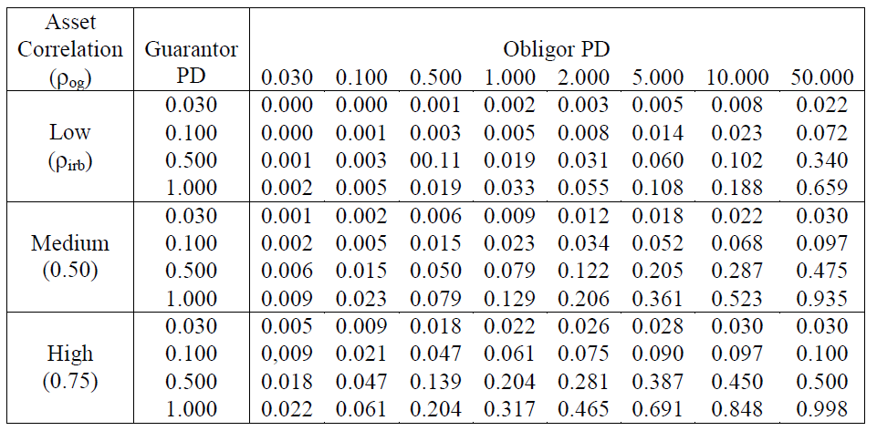
Credit Risk Mitigation
Double Default

Slide 9
Credit Risk Mitigation
Double Default
For example, If the obligor’s PD is 0.2% and PD of guarantor is 0.1%. Given the EAD = 200,000,000 bahts.
According from the table of joint probability
          EL_{obligor} = 200,000,000 * 2% = 4,000,000
        EL_{guarantor} = 200,000,000 * 1% = 2,000,000
        EL_{double Default} = 200,000,000 * 0.206% = 412,000
        ρ_{n,gn =} 0.5
        Benefit = 4,000,000 – 412,000 = 3,588,000

Slide 10
Credit Risk Mitigation
Collateral
Since guarantee is taking care of PD parameter, collateral will take the role of recovery rate.
Recovery Rate will depend on the quality of collateral and the liquidity of collateral.
The higher quality higher recovery rate (lower LGD), and the better liquidity the higher recovery rate as well.
There are two types in general of collateral
  Financial collateral ex. Cash, Shares, Debt Securities, Gold
  Physical collateral ex. Plants, Lands, Building.

Slide 11
Credit Risk Mitigation
Financial Collateral
Financial collateral is the most preferable collateral because it has high liquidity. However, financial collateral is subjected to the price volatility. That leads to “Residual Risk”
Residual Risk is the remaining risk that left over after credit mitigations. There is a possibility that when the time goes by, the value of collateral is going to decrease.
Then, the collateral may not cover the exposure. The reduced percentage of collateral is called “Haircut”
Therefore,
Collateral = Collateral x (1-Haircut)

Slide 12
Credit Risk Mitigations
Quantified Residual Risk
Financial collateral is easily to be liquidated at the market value and the price keep changing over time.
Thus, the method to quantify the extreme decrease value of the collateral is Value at Risk of collateral.
The time period for computing VaR must be equal to the holding period of the collateral (Normally, the holding period of financial collateral should not exceed 20 days.)
Consequently, the formula will be
Collateral = Collateral x (1-VaR_{Holding Period})

Slide 13
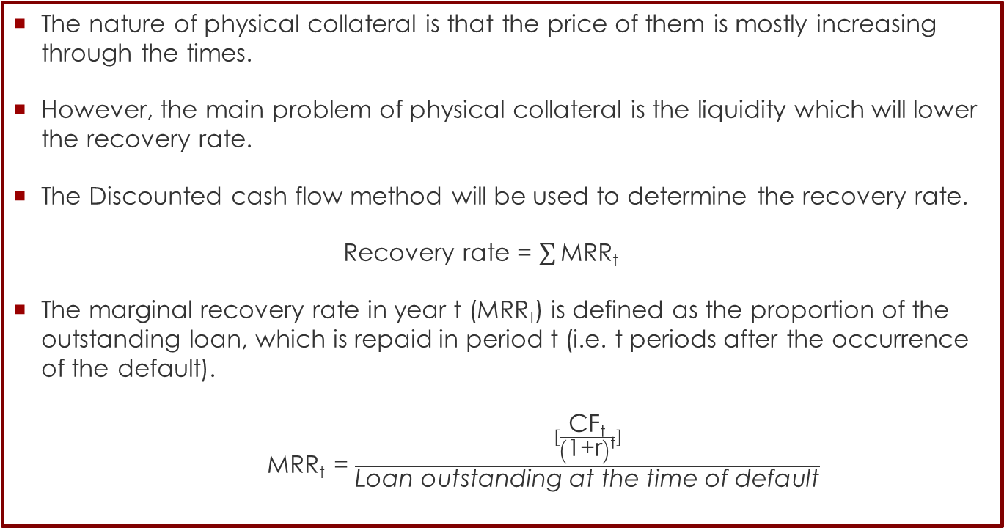
Credit Risk Mitigations
Physical Collateral
The nature of physical collateral is that the price of them is mostly increasing through the times.
However, the main problem of physical collateral is the liquidity which will lower the recovery rate.
The Discounted cash flow method will be used to determine the recovery rate.
Recovery rate = $\sum{\text{MRR}\text{t}}$
The marginal recovery rate in year t (MRR_{t}) is defined as the proportion of the outstanding loan, which is repaid in period t (i.e. t periods after the occurrence of the default).
MRR_{t} = $\frac{[\frac{\text{CF}\text{t}}{\left(\text{1+}\text{r}\right)\text{t}}]}{\text{Loan} \text{outstanding} \text{at} \text{the} \text{time} \text{of} \text{default}}$

Slide 14
Hedging Instruments
Credit Default Swap
Credit Default Swap is an instrument that provides insurance against the risk of a default by a particular company.
The company is known as the reference entity and a default by the company is known as a credit event.
The buyer of the insurance obtains the right to sell bonds issued by the company for their face value when a credit event occurs and the seller of the insurance agrees to buy the bonds for their face value when a credit event occurs.
The total face value of the bonds that can be sold is known as the credit default
swap’s notional principal.
The buyer of a CDS makes periodic payments to the seller until the end of the
life of the CDS or until a credit event occurs. These payments are usually made in arrears every quarter.

Slide 15
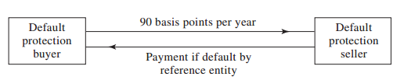
Hedging Instruments
Credit Default Swap
An example will help to illustrate how a typical deal is structured. Suppose that
two parties enter into a five-year credit default swap on December 20, 2015. Assume that the notional principal is $100 million and the buyer agrees to pay 90 basis points per year (quarterly in arrears) for protection against default by the reference entity.

Slide 16
Hedging Instruments
Credit Default Swap
If the reference entity does not default (that is, there is no credit event), the buyer receives no payoff and pays approximately
$225,000 (= 0.25 × 0.0090 × 100,000,000) on March 20, June 20, September 20,
and December 20 of each of the years 2016, 2017, 2018, 2019, and 2020.
If there is a credit event, a substantial payoff is likely. Suppose that the buyer notifies the seller of a credit event on May 20, 2018 (five months into the third year). If the contract specifies physical settlement, the buyer of protection has the right to sell to the seller of protection bonds issued by the reference entity with a face value of $100 million
the buyer would be required to pay to the seller the amount of the annual payment accrued between March 20, 2018, and May 20, 2018 (approximately $150,000), but no further payments would be
required.

Slide 17
Hedging Instruments
First-to-Default basket swap
The same as a single-name CDS except that payment is triggered when a credit event occurs to the first of a group of reference credits.
Basket has typically 3 to 10 reference credits.
Protection seller is exposed to each of the credits for the full amount but only to the first credit event among all reference credits.
Premium is paid as an annuity (like a CDS) or upfront (like an option).
Premium will be higher for:
  A larger number of reference credits in the basket
  Lower-quality reference credits
  Lower correlation among the reference credits

Slide 18
Hedging Instruments
Settlement
On occurrence of a credit event, the CDS is terminated and a settlement payment is made by the protection seller.
Termination value is calculated at time of credit event, according to the terms of contract.
Contract can be:
  Cash settled: payment may be the nominal value of the swap contract or the difference between nominal value and market value of reference asset at time of credit event.
  Physically settled: buyer delivers the reference asset to the seller, and seller pays face value of delivered asset. Contract may specify alternative assets (deliverable obligations) when CDS is based on a reference entity (a company) rather than on a specific asset. In this case, buyer would deliver the cheapest in the list of eligible assets
  (cheapest to deliver).

Slide 19
Hedging Instruments
Structured Credit Products
Funded investment products that arise from the securitization and
transfer of the total return of debt (loans or mortgages) to investors.
– The debt itself is not sold to investors.
Possible names for issuer:
  Special Purpose Vehicle (SPV): legal entity that buys a pool of assets
  (often illiquid or non-traded) and securitize them by selling a bond or
  note that matches the cash flows of the pool
  Structured Investment Vehicle (SIV): an arbitrage fund that typically
  buys long-term high-yield debt (e.g. corporate bonds or other
  structured products) and obtains funding by issuing short-term debt,
  such as the asset-backed commercial papers (ABCP).
  Conduit: a generic name for the types above and used in pass-through
  structures (when it acts as a simple “conductor” of cash flows from the
  pool of assets to investors).

Slide 20
Hedging Instruments
Structured Credit Products
Mortgage-Backed Securities (MBS)
  Bonds or notes whose cash flows are backed by the principal and
  interest payments of a pool of mortgages.
  The pool may contain hundreds of reference mortgages.
Asset-Backed Securities (ABS)
  Same as MBS but now the pool may include any type of Receivables:
  credit card payments, auto loans, home equity loans, student loans, or
  even aircraft leases and movie revenues.
  The securitized assets are often illiquid or private.
Collateralized Debt Obligations (CDO)
  More flexible ABS/MBS structures that allow for tranching of credit
  risk: investors of the most senior tranches bear the lowest risks, and so
  on.

Slide 21
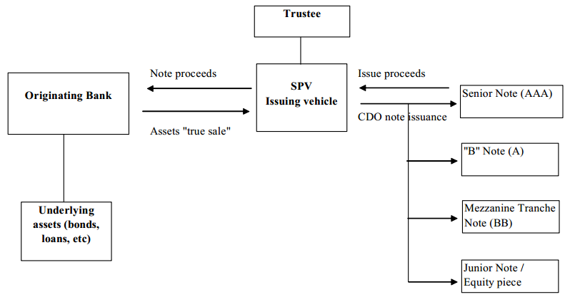
Hedging Instruments
Structured Credit Products

Slide 22
Credit Risk Mitigations
Reference
http://www.invoice-factoring.us/factoring_recourse.html
Košak, M., & Poljšak, J. (2010). Loss given default determinants in a commercial bank lending: an emerging market case study. Zbornik radova Ekonomskog fakulteta u Rijeci: časopis za ekonomsku teoriju i praksu, 28(1), 61-88.
Financial Instruments & Credit Derivatives Modelling Lecture 1:
Credit Derivatives Leonardo Nogueira, ICMA Centre 2011
Ebert, S., & Lütkebohmert, E. (2009). Improved Modeling of Double Default Effects in Basel II-An Endogenous Asset Drop Model without Additional Correlation. Bonn Econ Papers, (24).

Slide 23
Credit Risk Mitigations
Reference
Heitfield, E., & Barger, N. (2003). Treatment of double-default and double-recovery effects for hedged exposures under pillar I of the proposed New Basel Capital Accord. White Paper by the staff of the Board of Governors of the Federal Reserve System.

