Slide 1
FIN4811
Risk Management
Chapter Nine
Credit Risk Modelling
Nattanan Bovornsantisuth

Slide 2
Agenda
  Credit Spread
  Statistical Model for Credit Scoring
    Altman Z-score
    Credit Scoring for Retail
  KMV Model

Slide 3
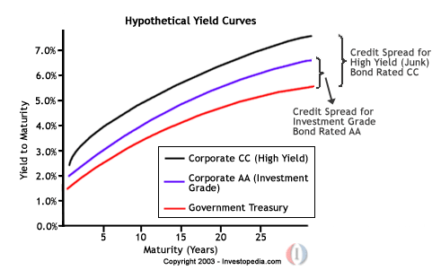
Credit Risk Modelling
Credit Spread
Credit Spread is the excess interest rate that the investors expect for bearing the credit risk
For example, bond yield spread can be estimated as the spread of corporate bond yield over risk free rate or treasury bond yield.

Slide 4
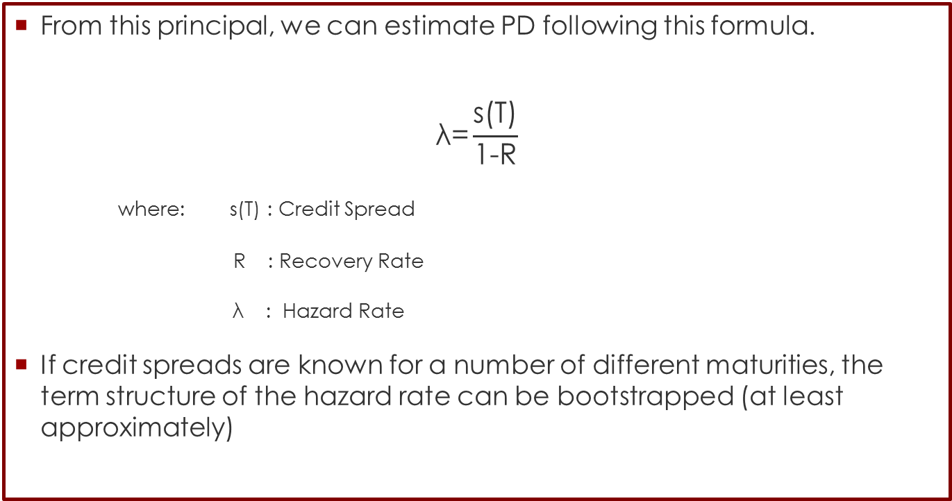
Credit Risk Modelling
Credit Spread
From this principal, we can estimate PD following this formula.
$$\text{λ}\text{=}\frac{\text{s}\text{(}\text{T}\text{)}}{\text{1−}\text{R}}$$
where: s(T) : Credit Spread
R : Recovery Rate
$\text{λ}\text{ : }\text{Hazard} \text{Rate}$
If credit spreads are known for a number of different maturities, the term structure of the hazard rate can be bootstrapped (at least approximately)

Slide 5
Credit Risk Modelling
Credit Spread
For example, Suppose that the CDS spread for 3-, 5-, and 10-year instruments is 50, 60, and 100 basis points and the expected recovery rate is 60%.
The average hazard rate over three years is approximately 0.005/(1 − 0.6) = 0.0125.
The average hazard rate over five years is approximately 0.006/(1 − 0.6) = 0.015.
The average hazard rate over five years is approximately 0.01/(1 − 0.6) = 0.025.
From this we can estimatethat the average hazard rate between year 3 and year 5 is (5 × 0.015 − 3 × 0.0125)/2 = 0.01875.

Slide 6
Credit Risk Modelling
Credit Spread
We do calculate PD through the expected loss from NPV of bonds
Suppose that a five-year corporate bond with a principal of 100 provides a coupon of 6% per annum (paid semiannually) and that the yield on the bond is 7% per annum (with continuous compounding). The yield on a similar risk-free bond is 5% (again with continuous compounding). The yields imply that the price of the corporate bond is 104.09 and the price of the risk-free bond is 95.34. The expected loss from default over the five-year life of the bond is therefore 104.09 – 95.34, or $8.75. For simplicity, we suppose that the unconditional probability of default per year is the same each year and equal to Q. Furthermore, we assume defaults can happen only at times 0.5, 1.5, 2.5, 3.5, and 4.5 years (immediately before coupon payment dates). Risk-free rates are assumed to be 5% (with continuous compounding) for all maturities and the recovery rate is assumed to be 40%.

Slide 7
Credit Risk Modelling
Credit Spread
We do calculate PD through the expected loss from NPV of bonds
Suppose that a five-year corporate bond with a principal of 100 provides a coupon of 6% per annum (paid semiannually) and that the yield on the bond is 7% per annum (with continuous compounding). The yield on a similar risk-free bond is 5% (again with continuous compounding). The yields imply that the price of the corporate bond is 104.09 and the price of the risk-free bond is 95.34. The expected loss from default over the five-year life of the bond is therefore 104.09 – 95.34, or $8.75. For simplicity, we suppose that the unconditional probability of default per year is the same each year and equal to Q. Furthermore, we assume defaults can happen only at times 0.5, 1.5, 2.5, 3.5, and 4.5 years (immediately before coupon payment dates). Risk-free rates are assumed to be 5% (with continuous compounding) for all maturities and the recovery rate is assumed to be 40%.

Slide 8
Credit Risk Modelling
Credit Spread
Setting this equal to the 8.75 expected loss calculated earlier, we obtain a value for Q of 8.75/288.48, or 3.03%.
Time (yrs) | PD | Recovery amount ($) | Default free value ($) | Loss ($) | Discount Factor | PV of EL($)
0.5 | X | 40 | 106.73 | 66.73 | 0.9753 | 65.08x
1.5 | X | 40 | 105.97 | 65.97 | 0.9277 | 61.20x
2.5 | X | 40 | 105.17 | 65.17 | 0.8825 | 57.52x
3.5 | X | 40 | 104.34 | 64.34 | 0.8395 | 54.01x
4.5 | X | 40 | 103.46 | 63.46 | 0.7985 | 50.67x
 |  |  |  |  | NPV= | 288.48x
3 + 3e^{−0.05×0.5} + 3e^{−0.05×1.0} + 103e^{−0.05×1.5} = 104.34

Slide 9
Credit Risk Modelling
Statistical Model for Credit Scoring
There are a lot of study trying to study what characteristics or factors that can impact on PD.
Most common statistical model using for finding PD is “Logistic Regression”
Logistic Regression, Logit, analysis are the multivariate techniques which allow for estimating the probability that an event occurs or not, by predicting a binary dependent outcome from a set of independent variables.
Linear discriminant analysis is to fi nd the so called discriminant function and to classify objects into one of two or more groups based on a set of features that describe the objects.

Slide 10
Credit Risk Modelling
Altman Z-score
Edward Altman has pioneered the use of accounting ratios to predict default. In 1968, he developed what has become known as the Z-score. Using a statistical technique known as discriminant analysis, he attempted to predict defaults from five accounting ratios:
  X1: Working capital/Total assets
  X2: Retained earnings/Total assets
  X3: Earnings before interest and taxes/Total assets
  X4: Market value of equity/Book value of total liabilities
  X5: Sales/Total asset

Slide 11
Credit Risk Modelling
Working capital/Total assets
The Working capital/Total assets ratio is a measure of the net liquid assets of the firm relative to the total capitalization.
Working capital is defined as the difference between current assets and current liabilities. Liquidity and size characteristics are explicitly considered.
Ordinarily, a firm experiencing consistent operating losses will have shrinking current assets in relation to total assets.
Of the three liquidity ratios evaluated, this one proved to be the most valuable. Inclusion of this variable is consistent with the Merwin study which rated the net working capital to total asset ratio as the best indicator of ultimate discontinuance.

Slide 12
Credit Risk Modelling
Retained earnings/Total assets
This measure of cumulative profitability over time was cited earlier as one of the "new" ratios.
The age of a firm is implicitly considered in this ratio.
For example, a relatively young firm will probably show a low RE/TA ratio because it has not had time to build up its cumulative profits. Therefore, it may be argued that the young firm is somewhat discriminated against in this analysis, and its chance of being classified as bankrupt is relatively higher than another, older firm, ceteris paribus. But, this is precisely the situation in the real world. The incidence of failure is much higher in a firm's earlier year

Slide 13
Credit Risk Modelling
EBIT/Total assets
This ratio is calculated by dividing the total assets of a firm into its earnings before interest and tax reductions.
In essence, it is a measure of the true productivity of the firm's assets, abstracting from any tax or leverage factors.
Since a firm's ultimate existence is based on the earning power of its assets, this ratio appears to be particularly appropriate for studies dealing with corporate failure.
Furthermore, insolvency in a bankruptcy sense occurs when the total liabilities exceed a fair valuation of the firm's assets with value determined by the earning power of the assets.

Slide 14
Credit Risk Modelling
Market value of equity/Book value of total liabilities
Equity is measured by the combined market value of all shares of stock, preferred and common, while debt includes both current and long-term.
The measure shows how much the firm's assets can decline in value (measured by market value of equity plus debt) before the liabilities exceed the assets and the firm becomes insolvent.
This ratio adds a market value dimension which other failure studies did not consider. It also appears to be a more effective predictor of bankruptcy than a similar, more commonly used ratio: Net worth/Total debt

Slide 15
Credit Risk Modelling
Sales/Total asset
The capital-turnover ratio is a standard financial ratio illustrating the sales generating ability of the firm's assets.
It is one measure of management's capability in dealing with competitive conditions. This final ratio is quite important because, as indicated below, it is the least significant ratio on an individual basis.
In fact, based on the statistical significance measure, it would not have appeared at all. However, because of its unique relationship to other variables in the model, the Sales/Total assets ratio ranks second in its contribution to the overall discriminating ability of the model.

Slide 16
Credit Risk Modelling
Estimating Linear Discrimination Analysis
Collect the sample of Non bankruptcy and bankruptcy companies (determined 1 for bankruptcy and 0 for Non bankruptcy
Compute those financial ratios of all firms
Run the linear Discrimination Analysis model to estimate the coefficient factors
According to Altman research paper in 1968, For publicly traded manufacturing companies, the original Z-score was
  Z = 1.2X₁ + 1.4X₂ + 3.3X₃ + 0.6X₄ + 0.999X₅

Slide 17
Credit Risk Modelling
The Interpretation of Z Score
> 3.0 The company is safe based on these financial figures only.
2.7 − 2.99 On Alert. This zone is an area where one should exercise caution.
1.8 − 2.7 Good chances of the company going bankrupt within 2 years of operations from the date of financial figures given.
<1.80 Probability of Financial embarrassment is very high.

Slide 18
Credit Risk Modelling
Example
Consider a company for which working capital is 170,000, total assets are 670,000, earnings before interest and taxes is 60,000, sales are 2,200,000, the market value of equity is 380,000, total liabilities is 240,000, and retained earnings is 300,000. In this case,
X1 = 0.254, X2 = 0.448, X3 = 0.0896, X4 = 1.583, and X5 = 3.284.
The Z-score is
1.2×0.254+1.4×0.448+3.3×0.0896+0.6×1.583+0.999×3.284 = 5.46
The Z-score indicates that the company is not in danger of defaulting in the near future.

Slide 19
Credit Risk Modelling
Credit Scoring for Retail
Risk scorecards have been used by a variety of industries for uses including predicting delinquency nonpayment—that is, bankruptcy—fraud, claims (for insurance), and recovery of amounts owed for accounts in collections.
Risk scoring, as with other predictive models, is a tool used to evaluate the level of risk associated with applicants or customers. While it does not identify “good” (no negative behavior expected) or “bad” (negative behavior expected) applications on an individual basis, it provides statistical odds, or probability, that an applicant with any given score will be “good” or “bad.”
These probabilities or scores, along with other business considerations such as expected approval rates, profit, churn, and losses, are then used as a basis for decision making.

Slide 20
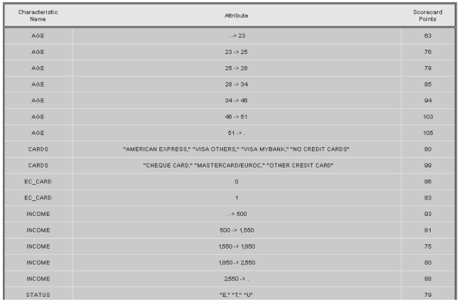
Credit Risk Modelling
Sample Scorecard (partial)

Slide 21
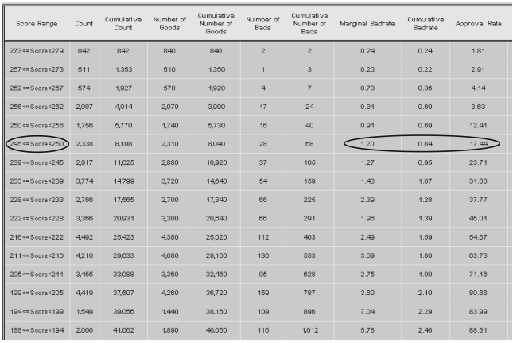
Credit Risk Modelling
Gains Chart

Slide 22
Credit Risk Modelling
Example for Credit Scoring Model
According to research paper of Asia Samreen and Farheen Batul Zaidi (2012), Design and Development of Credit Scoring Model for the Commercial banks of Pakistan: Forecasting Creditworthiness of Individual Borrowers, the researchers gather factors that can effect on credit scoring of individual in Pakistan. The selection of individual variables is
1 Gender | 9 Occupation
2 Client's locative situation | 10 Working period with the last employer
3 Education level | 11 Working period with the current employer
4 Proximity towards bank X branches | 12 Loan period
5 Marital status | 13 Banking references at Bank X
6 Age | 14 Monthly net income of the applicant
7 Number of dependents | 15 Credit History
8 Loan tenure | 16 Loan from other banks

Slide 23
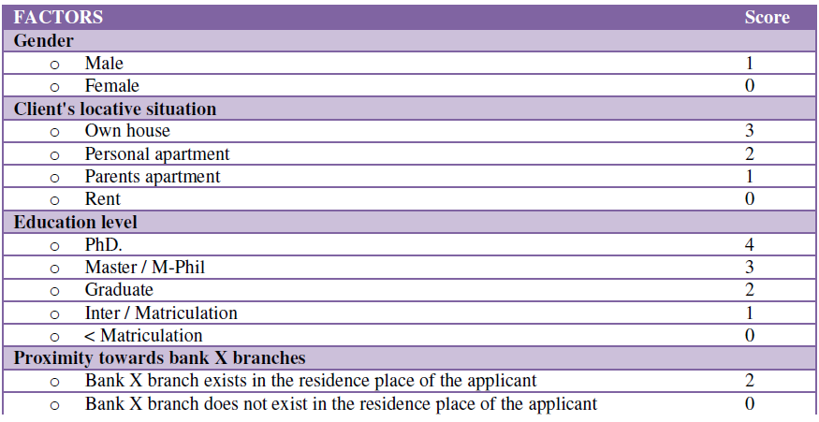
Credit Risk Modelling
Example for Credit Scoring Model

Slide 24
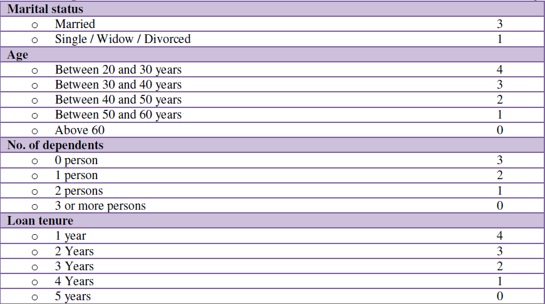
Credit Risk Modelling
Example for Credit Scoring Model

Slide 25
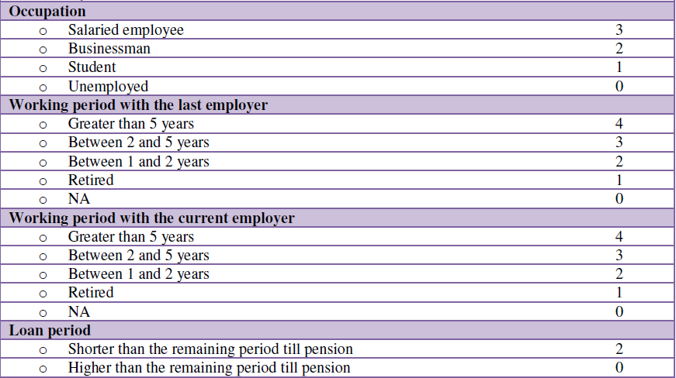
Credit Risk Modelling
Example for Credit Scoring Model

Slide 26
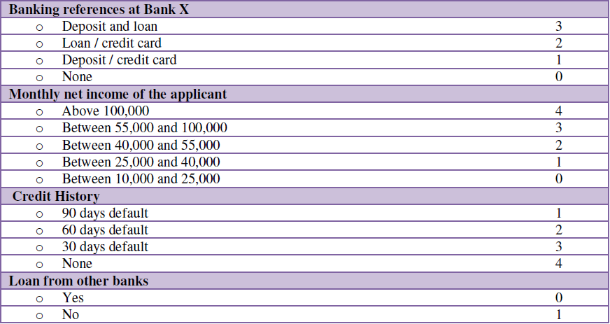
Credit Risk Modelling
Example for Credit Scoring Model

Slide 27
Credit Risk Modelling
Example for Credit Scoring Model

Slide 28
Credit Risk Modelling
Example for Credit Scoring Model
The result from Logistic Regression is that
Factor | Coefficient
Client’s_locative_situation | 3.257
Education_level | 5.233
Proximity_towards_BankX_Branches | 4.462
Marital_Status | 3.059
Occupation | -48.2
Working_period_with_the_last_employer | 4.496
Loan_period | 4.370
Banking_references_at_BankX | 4.496
Credit_History | -23.721

Slide 29
Credit Risk Modelling
Example for Credit Scoring Model
The result from Linear Discrimination Analysis is that
Factor | Coefficient
Gender | 0.081
Client’s_locative_situation | 0.305
Education_level | 0.089
Proximity_towards_BankX_Branches | 0.271
Age | 0.017
No._of_dependents | 0.422
Loan_tenure | 0.040
Marital_Status | 3.059
Occupation | 0.466

Slide 30
Credit Risk Modelling
Example for Credit Scoring Model
The result from Linear Discrimination Analysis is that (con’t)
Factor | Coefficient
Working_period_with_the_last_employer | 0.218
Working_period_with_the_current_employer | 0.261
Loan_period | 0.224
Banking_references_at_BankX | 0.260
Monthly_Net_Income_of_the_applicant | 0.173
Credit_History | 0.671
Loan_from_other_banks | 0.024

Slide 31
Credit Risk Modelling
Merton Model
The firm’s assets (V_{T} ) are equal to the value of debt (D) plus equity (E_{T})
If V_{T} < D, it is (at least in theory) rational for the company to default on the debt at time T. The value of the equity is then zero. If V_{T} > D, the company should make the debt repayment at time T and the value of the equity at this time is V_{T} − D. Merton’s model, therefore, gives the value of the firm’s equity at time T as
E_{T} = max(VT − D, 0)
This shows that the equity of a company is a call option on the value of the assets of the company with a strike price equal to the repayment required on the debt.

Slide 32
Credit Risk Modelling
Merton Model
In 1974, Merton proposed a model where a company’s equity is an option on the assets of the company. Suppose, for simplicity, that a firm has one zero-coupon bond outstanding and that the bond matures at time T. Define
V₀ : Value of company’s assets today.
V_{T} : Value of company’s assets at time T.
E₀ : Value of company’s equity today.
E_{T} : Value of company’s equity at time T.
D : Amount of debt interest and principal due to be repaid
σ_{V} : Volatility of assets (assumed constant).
σ_{E} : Instantaneous volatility of equity.

Slide 33
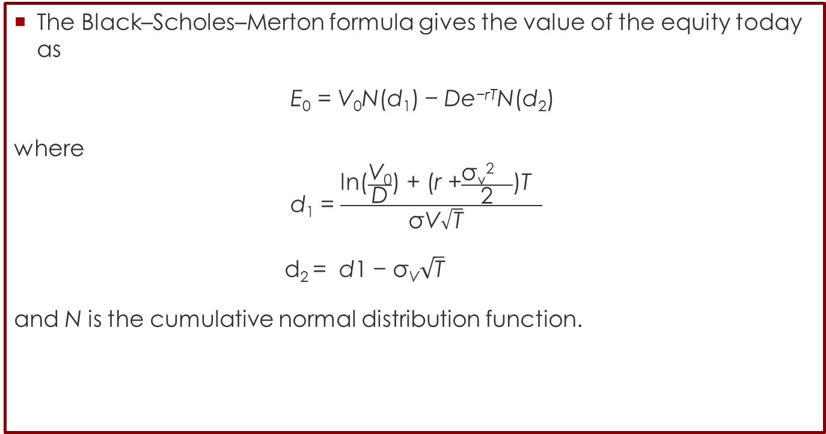
Credit Risk Modelling
Merton Model
The Black–Scholes–Merton formula gives the value of the equity today as
E₀ = V₀N(d₁) − De^{−rT}N(d₂)
where
d₁ = $\frac{\text{ln}\text{(}\frac{\text{V}\text{0}}{\text{D}}\text{) + (}\text{r} \text{+}\frac{\text{σ}\text{v}\text{2} }{\text{2}}\text{)}\text{T} }{\text{σ}\text{V}\sqrt{\text{T}} }$
d₂ = d1 − σ_{V}$\sqrt{\text{T}}$
and N is the cumulative normal distribution function.

Slide 34
Credit Risk Modelling
KMV Model
The KMV model is an important example of industry model derived from Merton’s one.
A fundamental quantity in the KMV model is the Expected Default Frequency, EDF.
The EDF is nothing but the probability that a given firm will default within 1 year according to the KMV methodology.
In order to understand the way in which KMV obtains the EDF, we can use Merton’s model.
In Merton’s model the 1-year PD of a firm is given by the probability that in 1 year the asset value will be below threshold .

Slide 35
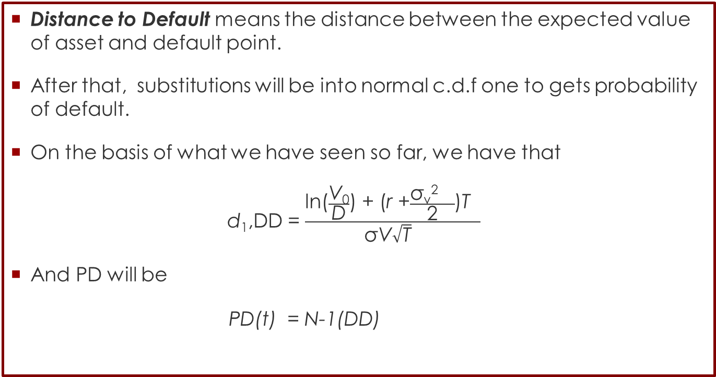
Credit Risk Modelling
KMV Model
Distance to Default means the distance between the expected value of asset and default point.
After that, substitutions will be into normal c.d.f one to gets probability of default.
On the basis of what we have seen so far, we have that
d₁,DD = $\frac{\text{ln}\text{(}\frac{\text{V}\text{0}}{\text{D}}\text{) + (}\text{r} \text{+}\frac{\text{σ}\text{v}\text{2} }{\text{2}}\text{)}\text{T} }{\text{σ}\text{V}\sqrt{\text{T}} }$
And PD will be
PD(t) = N-1(DD)

Slide 36
Credit Risk
Reference
Jorion, P. Financial Risk Manager Handbook, 4th Edition.
Hull, J. (2006). Options, futures, and other derivatives. Upper Saddle River, N.J: Pearson/Prentice Hall.
Samreen, A., & Zaidi, F. B. (2012). Design and development of credit scoring model for the commercial banks of Pakistan: Forecasting creditworthiness of individual borrowers. International Journal of Business and Social Science,3(17).
Greene, William H. "A statistical model for credit scoring." (1992).
Altman, E. I. (2000). Predicting financial distress of companies: revisiting the Z-score and ZETA models. Stern School of Business, New York University, 9-12.

