Slide 1
FIN4811
Risk Management
Chapter Seven
Operational Risk
Nattanan Bovornsantisuth

Slide 2
Agenda
  Definition
  Scope of Operational Risk
  Benefits of Operational Risk
  Types of Operational Risk
    Strategy Risk
    People Risk
    Processes and System Risk
    External Event
  Measurement

Slide 3
Operational Risk
Definition
According to “Designing an Operational Risk Framework from a Bottom-up Perspective”, Operational risk is defined
“The potential for loss due to failures of people, processes, technology and external dependencies”
  According to Basel Committee, the definition is
  “Operational risk is the risk of loss resulting from inadequate or failed internal processes, people and systems or from external events”
According to Financial Services Authority, it mentioned that
“Consider a more specific definition of operational risk that is appropriate to the range and nature of its business activities and its operating environment”

Slide 4
Operational Risk
Scope of Operational Risk
Business risk, which includes adverse changes to a firm’s market, customers or products, changes to the economic and political environments in which the firm operates and strategic risk which a firm faces if business plans, supporting systems and the implementation of these plans adversely affect the firm.
Crime risk including potential theft, fraud and computer hacking.
Disaster risk such as fires, floods and other natural disasters and terrorist activity
Information technology risk, including unauthorised access and disclosure, and data corruption

Slide 5
Operational Risk
Scope of Operational Risk
Legal risk including loss arising from legal action against it and from inadequate, incomplete or otherwise unsound legal documentation and practices
Regulatory risk relating to the lack of observance of rules set by a regulatory body.
Reputational risk from negative publicity about its business practices or internal controls.
Systems risk loss as a result of failure caused by the breakdown of business procedures, processes or systems and controls.
Outsourcing.

Slide 6
Operational Risk
Benefits of Operational Risk
Improving the ability to achieve its business objectives.
Providing management the opportunity to focus on revenue generating activities rather than fire-fighting one crisis after another.
Minimising day-to-day losses
Providing a more robust enterprise risk management system.
Contributing to the establishment of a system which enables the correlation of different classes of risk to be understood and, where appropriate, modelled.

Slide 7
Operational Risk
Types of Operational Risk
    Strategy Risk
    People Risk
    Processes and System Risk
    External Event

Slide 8
Strategy Risk
Definition
  Strategy
    “Strategy is a description of what the business will do and the rationale behind it.”
    For example, Virgin Mail Order’s early strategy
    for music record sales was to compete in the market place by means of mail order (as its company name suggests), undercutting prices offered by the existing well-established high street retailers.
  Strategy risk
    “Strategic risk, then, may be defined as the risk associated with initial strategy selection, execution or modification over time, resulting in a lack of achievement of overall objectives.”

Slide 9
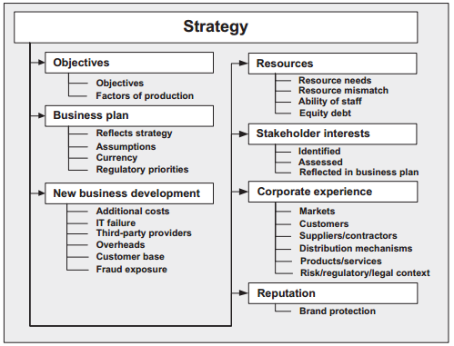
Strategy Risk
Types of Strategy Risk

Slide 10
Strategy Risk
Objective
Objectives are the foundation for designing the organisational structure and processes of a business as well as the work of individual business units and managers.
There are potentially five principal areas of risk associated with setting objectives:
  Objectives are not aligned to the strategy
  They do not cover the key business areas.
  They are not SMART (Specific, Measurable, Achievable, Relevant to context of business vision, and Time bound)
  Management lacks of experience in achieving similar objectives.
  The initial assessment of the risks associated with each objective is superficial.

Slide 11
Strategy Risk
Business Plan
The business plan is required to “tell a story” and explain how the business will achieve its objectives in a comprehensive, coherent, consistent and cohesive manner.
Series of potential areas of risk associated with creating and implementing a business plan.
  Not readily articulating the strategy
  Not explaining how the objectives will be accomplished, particularly at start-up through short-term detailed operating plans
  Not making the assumptions explicit
  Not identifying the risks (and their responses) associated with the assumptions, not taking account of regulatory priorities (if applicable)
  Not updating the risks to the objectives or being regularly updated.

Slide 12
Strategy Risk
New Business Development
This risk category refers to the risks associated with plans for entering new business areas, expansion through mergers and acquisitions, providing new services and enhancing infrastructure (e.g. physical plant and equipment, as well as information technology and networking).
Activity attracts additional risks
  Lack of recovery of additional research and development or marketing costs.
  Failure of new information technology and the associated loss of reputation; poor performance by third-party providers.
  Overheads and staff costs from high-volume, low-margin services outweighing the corresponding increase in profits
  New services not attracting new customers or the new services attracting higher losses due to fraud or theft.
To mitigate strategic risk, management should have a strategic planning process that addresses its retail payment business goals and objectives, including supporting information technology components

Slide 13
Strategy Risk
Resources
Resources will include capital, energy, raw materials, people, buildings, land and machinery.
Risks to resources relate to:
  Lack of comprehension of resource needs to meet objectives
  Mismatch between objectives and existing resources
  Mismatch between production/sales projections and procurement of planned resources
  Experience, qualifications and technical ability of staff
  Mismatch between equity-debt and spend profile.

Slide 14
Strategy Risk
Stakeholder Interests
Stakeholders are those individuals or organisations who can affect or be affected by the business. They include shareholders, lenders, employees, suppliers, business partners, customers, analysts and in some instances society at large.
Stakeholders are likely to have conflicting interests or different priorities. Hence, they should be recorded, disseminated, openly debated (when appropriate) and where possible aligned through negotiation.
Stakeholder requirements should be reflected in the business plan; if omitted, they could be the source of problems in the long term.

Slide 15
Strategy Risk
Corporate Experience
A business’s corporate experience will reflect on the risk exposure profile of the business’s strategy. Issues reflecting corporate experience will include knowledge of markets, customers, suppliers, contractors, distribution mechanisms, products and services, and the legal and regulatory constraints (compliance requirements) of the industry. This is not an exhaustive list and will vary depending on the service provided, market segment and the industry.

Slide 16
Strategy Risk
Reputation
One significant measure of a business’s reputation is its brand value. Successful branding can secure long-term competitive advantage. Customers can be persuaded that a product is different from its rivals to such a degree that they believe the rival product(s) to be inferior (regardless of whether this is the case or not).
A poor reputation can impede the sale of goods or services, harm the recruitment of high-calibre staff, deter desirable business partners, and/or make debt more expensive to obtain. Core value statements, which talk about trust and honesty, need to be shared and put into practice throughout an organisation.
More and more consumers are interested in anything related to a brand, from the ingredients of its products to an organisation’s behaviour on environmental issues and beyond to a wide range of other economic, social and political issues.

Slide 17
People Risk
Definition
A business must establish appropriate systems and controls for the management of “people risk” that may result from the actions of employees or the business itself.
People risk may be described as a combination of the detrimental impact of employee behaviour (which may occur anywhere on the continuum between profit erosion and business failure)and employer behaviour (which impairs employee efficiency, health and safety or loyalty).
Impact of people risk can be described as having three levels of severity
  The lowest level people risk may be defined as events which, should they materialise, would rode profitability, share value and/or credit rating in the short term.
  The intermediate level, people risk events may have a detrimental impact on the business’s wealth or reputation in the long term.
  The highest level, people risk events may bring about the eventual collapse of a
  business, as a result of the conscious or unconscious actions of one or more employees.

Slide 18
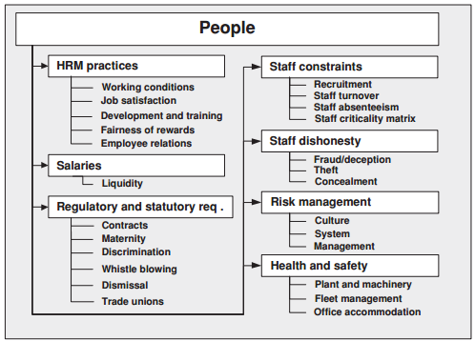
People Risk
Types of People Risk

Slide 19
People Risk
Human Resource Management Practices
HRM is a term which stresses the development of people as assets rather than describing their control simply in terms of a cost to be managed; it places people management at the strategic heart of business planning.
HRM seeks to use the personnel policy areas of employee resourcing, employee development, employee relations and rewards within a broad strategic plan for the people part of the business in order to improve or sustain an organisation’s competitive advantage.
HRM can contribute to the improvement of working conditions, the creation of job satisfaction, the development and training of employees, the maintenance of harmonious relationships and the fairness of rewards.
It can also assist with the threats to organisations, such as low productivity, unfair dismissals, absenteeism, accident sand social abuses (such as bullying), stress induced by unrealistic workloads, and sexual and racial discrimination.

Slide 20
People Risk
Ability to Pay Salaries
Consideration of employee remuneration requires an assessment of the adequacy of the risk indicators and their ability to provide accurate and timely information upon which management can act. Payment of salaries is clearly a liquidity issue. The salary burden must be managed against the current and anticipated income, by balancing staff numbers accordingly.

Slide 21
People Risk
Regulatory and Statutory Requirements
Contracts
  in a contract of employment, there must be an offer and an acceptance, which is in effect the agreement. There must be: an intention to create legal relations, consideration, capacity, consent of the parties, and no mistake, misinterpretation, duress or undue influence.
Maternity
  Under the ERA a pregnant employee who has, on the advice of her doctor, midwife or health visitor, made an appointment to obtain antenatal care must have the time off to keep it and must also be paid.
Discrimination
  Discrimination is prohibited in relation to those protected regarding recruitment, pay and benefits, promotion, training, terms and conditions, transfers, dismissal, action short of dismissal and any other detriment.

Slide 22
People Risk
Regulatory and Statutory Requirements
Whistleblowing
  After the enactment of the Public Interest Disclosure Act 1998, workers who “blow the whistle” about any wrongdoing within their employer’s organisation are protected (as far as the “umbrella” of the Act extends).
Dismissal
  The risk for any employer in releasing a member of staff is not
  adhering to the prevailing legislation relating to wrongful and unfair dismissal. An employee can claim that they were wrongfully dismissed in a common law action for breach of contract in the civil courts or in an industrial tribunal.
Trade Unions

Slide 23
People Risk
Staff Constraints
Recruitment
  Recruiters : The effectiveness of the recruitment process will be influenced by the behavioural characteristics of the recruiter in terms of whether they are personable, enthusiastic and competent.
  Job analysis : an organisation needs to understand: the roles the job holder has to fill; the tasks the job holder will have to do; and the skills the job holder will need to carry out to complete the tasks allocated to the role.
  Job descriptions : To be effective, job descriptions must use statements that are terse, direct and simply worded.
  Interviews. Interviews remain the mainstay of the selection process. However, they can be plagued by problems of subjectivity and personal bias.
  Selection. Selection must contain a screening process to establish the fitness and propriety of employees, including their honesty, integrity, reputation, competence, capability and financial soundness.
  Induction of employees. A risk to any business is a poor induction process. It seldom receives the very careful attention it deserves. It makes good sense to help new recruits to integrate into their new surroundings and hence become efficient and effective in their work as quickly as possible.

Slide 24
People Risk
Staff Constraints
Staff Turnover
  retention of top performers critical to the success of the business;
  retention and development of the organisation’s knowledge base;
  retention of information which would be useful to a competitor;
  a reduction in advertising and recruitment agency costs;
  improved employee morale;
  a reduction in the time managers are diverted away from activities directly contributing to
  business creation;
  a reduction in the amount of time existing staff spend in inducting and training new staff;
  and
  a reduction in the time that staff are not fully productive in terms of those working their notice or new arrivals.

Slide 25
People Risk
Staff Constraints
Staff Absenteeism
  How frequently employees are absent from their work – the absenteeism rate – is also directly related to human resource planning and recruitment.
  While an employer may find that the overall absenteeism rate and costs are within an acceptable range, it is still advisable to study the statistics to determine if there are patterns in the data.
  By monitoring these differential attendance records, managers can assess where problems might exist and more importantly begin planning ways to resolve or improve the underlying causes.
  Employers look at “stick and carrot” regimes where progressive discipline procedures are applied to employees having a recurring record of absenteeism whereas incentives are provided for perfect attendance.

Slide 26
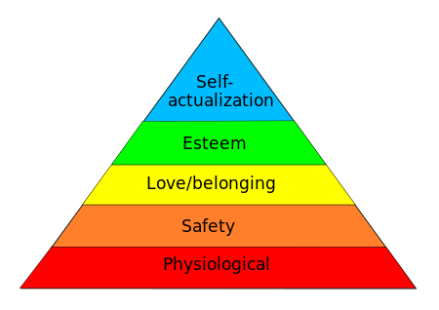
People Risk
Staff Constraints
Maslow Pyramid
World famous psychological
theory which describe about
the motivation of people in work

Slide 27
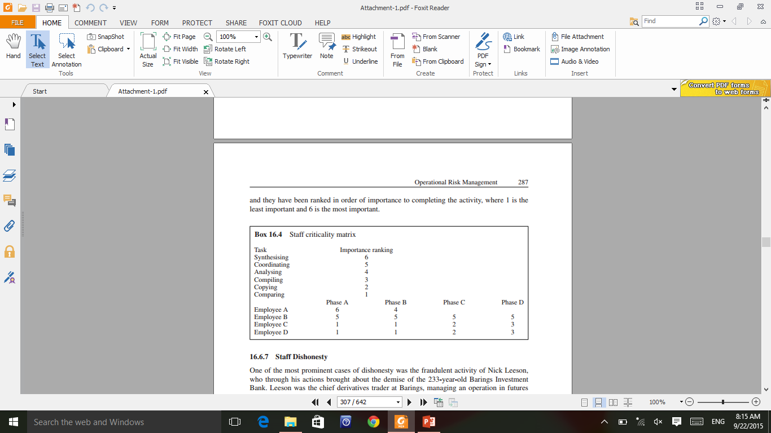
People Risk
Staff Constraints
Staff Criticality Matrix
  A staff criticality matrix can be developed which will show visually which individual is carrying out a critical task during any one phase of an activity and hence whose unplanned or unexpected departure could threaten the completion date of the overall activity.
  In this way consideration can be given to the proactive measures to be taken to compensate for the loss of a key member of staff at a critical moment in the completion of an activity.

Slide 28
People Risk
Staff Dishonesty
One of the most prominent cases of dishonesty was the fraudulent activity of Nick Leeson, who through his actions brought about the demise of the 233-year-old Barings Investment Bank.
Leeson was the chief derivatives trader at Barings, managing an operation in futures markets on the Singapore Monetary Exchange buying and selling derivatives futures pegged to the Nikkei 225 stock index.
He ran up liabilities of $1.38 billion hidden in his “88888”
account, more than the entire capital reserves of the bank.
Investors saw their savings wiped out and some 1200 employees lost their jobs.
The Dutch bank ING agreed to assume nearly all of Barings’ debt and acquired the bank for the princely sum of £1. In December 1995 a court in Singapore sentenced him to 6 1 2 years in prison after he had pleaded guilty to two counts
of deceiving the bank’s auditors and cheating the Singapore exchange.

Slide 29
PROCESSES AND SYSTEMS
Definition
Process and Systems
“These systems and controls commonly span a business’s end-to-end
operating cycle.”
Process and Systems Risk
“Processes and systems risk may be defined as the failure of processes or systems due to their poor design, complexity or non-performance, giving rise to operational losses. As a result a business may experience a wide range of problems, including an inability to meet orders, poor quality control, settlement processing errors, fraud and information security failure.”

Slide 30
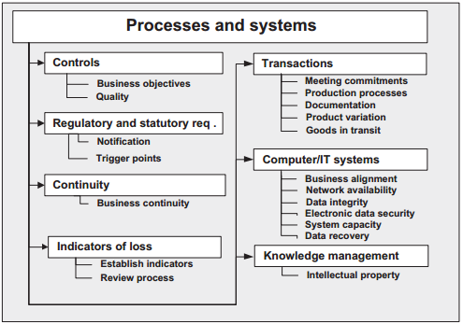
PROCESSES AND SYSTEMS
Types of Process and Systems

Slide 31
PROCESSES AND SYSTEMS
Control
There are three major characteristics of controls in business enterprise:
  Controls can neither be objective nor neutral.
  Controls need to focus on results.
  Controls are needed for measurable and non-measurable events.
The risk associated with controls is their lack of quality. If they are not economical, meaningful, appropriate, congruent, timely, simple and operational, they will hinder rather than improve management.
Simple controls are needed so that they are readily understood. Otherwise they confuse, absorb too much time and, most importantly, do not permit control.

Slide 32
PROCESSES AND SYSTEMS
Regulatory and Statutory Requirement
Those companies listed on the exchange and required to abide by the Listing Rules and Handbook and are required to notify the FSA of any operational risk that may have a significant regulatory impact.
This requirement includes notification of a significant failure in systems
and controls, a significant operational loss or the intention to enter or significantly change a material outsourcing arrangement.
Hence, just having controls is not enough. It must be possible to discern when they are not being effective.
Pre-agreed trigger points are required so that a notification is issued to the FSA when certain parameters are exceeded.

Slide 33
PROCESSES AND SYSTEMS
Continuity
A business must make arrangements for the continuity of its operations in the event that a significant process or system becomes unavailable or destroyed. This risk relates to IT service outages and unreliability causing disruption to the business.
Actively managing this attribute of risk requires capabilities in incident and problem management, IT service management, business continuity and disaster recovery.
In many businesses temporary loss of primary computer systems can cause significant disruption of business processes, while permanent damage to critical servers and/or software applications can suspend business operations for days.

Slide 34
PROCESSES AND SYSTEMS
Continuity
The risk indicators are used to facilitate regular quantitative assessment and monitoring of risk exposures and mitigating responses.
Indicators are tailored to suit a business’s specific services and operating context. Typical indicators are:
  bank borrowing against credit limits;
  cost of raw materials;
  sales revenue;
  third-party defaults;
  shareholder complaints;
  lawsuits;
  business continuity events.
  customer complaints.
  contracts secured and contracts lost.

Slide 35
PROCESSES AND SYSTEMS
Transactions
A common process risk for any business relates to the processing of transactions. Transaction risk relates typically (but not exclusively) to the manufacturing sector.
  Production Processes
    Common process risk is product defects. The goal was to continue to reduce the variability in processes until zero defects became an obtainable goal.
  Documentation Risk
    Decisions made as the result of information contained in documentation which is incomplete, incorrect, inconsistent, open to interpretation, time expired and so on may result in inappropriate or misguided business activity.
  Product Variation Risk
    Variability risk is the risk experienced by manufacturers where a customer requires: (1) a specific feature of their product that when added distinguishes the product from otherwise identical products; and (2) the modified product to be sent to a specific destination, when that product is typically distributed among several locations
  Goods-in-Transit Risk
    goods in transit, which he describes being composed of three key areas: theft,
    accumulation risks and recoveries.

Slide 36
PROCESSES AND SYSTEMS
Computer/IT Systems
IT systems include the computer systems and information technology infrastructure required
for the automation of processes and systems, such as application software, operating system software, network infrastructure, and desktop and server hardware.
Business Alignment
  The board must be assured that its IT system reflects its business needs and that the organization is exploiting the system to full advantage.
Network Availability
  The automation of processes and systems may reduce a business’s susceptibility to people risks such as human error, but will increase a business’s dependency on the reliability of its IT systems. If centralised systems go down then all hosted services go down, information processing ceases and all users are impacted.
Data Integrity
  Corrupted or degraded data is as valueless as data that is completely lost, when the extent of corruption or degradation is unknown. When discovered, corrupted information cannot be used until it has been checked, double-checked and confidence in its use has been restored.

Slide 37
PROCESSES AND SYSTEMS
Computer/IT Systems
Electronic Data Security
  Security of electronically held data is a serious risk, which, because of the internet, now
  has a global perspective. The information held in electronic form within a
  business’s information systems needs to be protected against unauthorised access, which may result in theft, corruption, corporate espionage and/or disclosure. The risk can originate from inappropriate access to or use of technology from inside the business, but more commonly from outside it.
System Capacity
  Basically system capacity relates to the amount of memory on a server which impacts all
  businesses. However, with the growth of the internet and e-commerce, system capacity can relate to the number of individuals that can access a system at any one time.
Data Recovery/Loss
  Back-ups have been used since the earliest beginnings of IT, when the inherent unreliability of the hardware necessitated rigorous copying of data, and the frequent use of the backed-up data.

Slide 38
PROCESSES AND SYSTEMS
Knowledge Management
A company’s knowledge or intellectual property is usually the basis of the company’s current success. The security of that information is key to competitive advantage. Hence, a key component of knowledge management is keeping commercially sensitive information, which would be useful to competitors, secure.
How successful a company is in this task depends on a company’s information culture.
Intellectual Property
  The rules for intellectual property protection between different countries are neither
  uniform nor equally enforced. The tracking of online dissemination and use of intellectual
  property, as well as the capability to collect payment, is not well developed in interactive networks.
  Companies can also be exposed and vulnerable when working in collaboration with other companies on large projects, when under normal circumstances
  these companies would be competitors.

Slide 39
PROCESSES AND SYSTEMS
Project Management
A fundamental aspect of project management is people management – working through others and relying on their timely collaboration to achieve the project objectives.
Each project will have its own unique risk profile and will require the discipline of risk management to provide greater certainty of achieving its objectives.
Large projects, when they fail or do not achieve their objectives, may have a debilitating effect on a business or may in extreme cases bring about their downfall.
Example
  Railtrack plc in the UK and Boeing in the US, for instance, have both experienced serious project problems that have shaken them to the core. It is reported that Railtrack was placed into administration due predominantly to the lack of performance of the West Coast Main Line project.

Slide 40
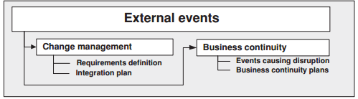
External Event
Project Management
External events are events that occur outside the business, which may require
a response in the form of change management (such as organisational change) or the instigation of contingency events to cope with, say, a natural disaster.

Slide 41
External Event
Definition and Types
External events are events that occur outside the business, which may require
a response in the form of change management (such as organisational change) or the instigation of contingency events to cope with, say, a natural disaster.

Slide 42
External Event
Change Management
The introduction of change needs to be handled with care to avoid a series of common risks.
Where radical IT change is planned it is often prudent to consider the implementation of a small pilot study initially to understand the implications of the change and how they may be best addressed.
A significant change management project usually warrants an integration plan to raise awareness of the change in advance of the deployment of the solution and to ease its introduction with the aid of familiarisation and training sessions appropriate to each of the disparate user groups.
Deployment of the change into the business environment should follow established channels. Existing user champions, system experts and user group members would be the natural and ogical choice for educating the users of the new system to support the integration and use of the system at the earliest opportunity.

Slide 43
External Event
Business Continuity
Business continuity management is a holistic management process that identifies potential impacts that threaten an organisation and provides a framework for building resilience and the capability for an effective response, which safeguards the interests of its key stakeholders, reputation, brand and value creating activities.
Events Causing Disruption
  There are a number of issues that can disrupt businesses, or in severe circumstances put them out of business such as attacks by animal rights activists, computer hackers and terrorists
Business Continuity Plans
  The survey also uncovered that 53% of organisations had no business continuity plan. It was found that the production of business continuity plans was more prevalent in companies with an annual turnover of £11 million.

Slide 44
Measurement and Mitigation
Definition
Measurement of Operational Risk
  to be able to prioritise management action and focus on those issues likely to have the greatest detrimental effect on the operation of the business, it is necessary to measure their likely impact.
  To accomplish this measurement it is necessary to have both historical data and high-powered analytical tools.
Mitigation of Operational Risk
  The success of mitigation will depend on a number of things. It will depend for instance
  on:
    The degree to which risk management is embedded in the business and championed from the top.
    The robustness of the risk identification process; the willingness and the desire of
    senior management to distil from the assessment process the priority issues and take the time to prepare specific tailored risk response actions.
    The experience of senior management of the risk exposure issues being addressed.
    the comprehensiveness of the approach.

Slide 45
Measurement and Mitigation
Impact
Impact Ranking | Financial Impact | Non-Financial Impact
 | Loss | Service Delivery | Brand Name / Reputation | Regulation / Legal
Catastrophic | >5,000,000 baht | Service can deliver up to 80% | The effect publish on public more than 3 days | Company is suspended
Major | 100,000 – 5,000,000 baht | Service can deliver up to 50-80% | The effect publish on public less than 2 days | Company is fined
Moderate | 50,000 – 100,000 baht | Service can deliver up to 20-49% | The effect publish on public less than 2 days | Warning by regulators
Minor | 10,000 – 50,000 baht | Service can deliver up less than 20% | The would be complain from customer | Regulator ask for the fact.
Insignificant | < 10,000 baht | Minor interruption but service can still deliver | Internal Complain | Regulator enjoin the incident

Slide 46
Measurement and Mitigation
Impact
 | Insignificant | Minor | Moderate | Major | Catastrophic
Catastrophic | Major | Major | Major | Catastrophic | Catastrophic
Major | Major | Major | Major | Catastrophic | Catastrophic
Moderate | Moderate | Moderate | Major | Major | Major
Minor | Minor | Minor | Moderate | Major | Major
Insignificant | Insignificant | Insignificant | Moderate | Major | Major

Slide 47
Crisis Management
Definition
“Crisis” is defined as a severe threat that can cause the damage to the operation if it is not be handle very well.
A crisis can create three major threats
  Public safety – such as the contamination of the product that might be able to harm the customers.
  Financial loss – can be cause by disruption of the operation.
  Reputational loss – the crisis does occur the reputation will be ruin.
“Crisis Management” means a design procedure or plan to prevent of minimize loss the can be happened from the crisis
In order to management the crisis efficiently, all step must be follow sequentially.

Slide 48
Crisis Management
Crisis Management Process
Pre-crisis
Most concern in the plan to prevent and preparation.
Crisis Response
Will defined what management need to do when crisis occur
Post Crisis
Prepare for the next crisis and do the commitment during the crisis

Slide 49
Crisis Management
Pre-Crisis Phase
Preparation
Crisis Management plan
- Provide the list of key concept and list of pre-assigned task
Crisis Management Team
- Set a team from the relevant departments
Spokesperson
- Training and prepare the spokesperson to confront with the public,
Pre –draft Message
- Create the draft with the accuracy and wisely choose the channel of communication

Slide 50
Crisis Management
Crisis Media Training
Try to avoid using the word “ No Comment” because the public is enthusiastic to get the truth or fact from the company. Thus, if using that word, public will believe that there is something to hide.
Avoid using the difficult/complex or technical terms. It will cause the public to not be able to clarify the fact and they might interpret that company is trying to cover something.
Confront with the public camera with the strong eye contract, try to avoid “uhms” or “uhs”, and not perform distracting nervous gestures because people might thing that you are perceived as deceptive.
Brief all spokesman on the latest information and the key message point to convey the stakeholders.

Slide 51
Crisis Management
Crisis Response
Crisis Response can be classified into two section:
  The initial crisis response
  Reputation repair and behavioral intentions.
Initial Response is to conduct the guidelines which focuses on three points:
  Be quick – Crisis Manager should response on the event in the first hour. The preparation will be helpful in this case.
  Be accurate – People need to know the truth about what happened and how the event might affect them
  Be consitant – The crisis team need to share all information to ensure that everyone in the firm understand and speak the same thing.

Slide 52
Crisis Management
Crisis Response
Reputation Repair is to regain the trust from the public to the firm or the brand.
The reputation repair strategies vary in term of how much the firm is going to treat the victim instead of addressing the public concerns.
There are two step of tackle reputation repair
  Determine the basic crisis type. A crisis manager considers how the news, media and stakeholder define the crisis. Classification of crisis can help to evaluate the attribution of crisis response. Crisis can be categorized to be three level:
    Victim Crises: Minimal Crisis Responsibility – Natural Disaster, Rumors, and Workplace Violence
    Accidental Cries: Low Crisis Responsibility – Technical error
    Preventable Cries: Strong Crisis Responsibility – Human error
  Review the intensifying factors of crisis history and prior reputation. If an organization has a same historical crisis, the threat can be intensified.

Slide 53
Crisis Management
Post Crisis Phase
Follow up the communication
Deliver what you promise with the public
Evaluate the crisis plan
See what is working and what is needed to improved.
Release the update on recovery process or the investigation.

Slide 54
Reference
Reference
Simple Tools and Techniques for Enterprise Risk Management, Second Edition, Robert J. Chapman, published by John Wiley and Sons Ltd (2011)
Coombs, W. T. (2007). Crisis management and communications. Institute for public relations, 4(5), 6.

