Slide 1
FIN4811
Risk Management
Chapter Four
Liquidity Risk
Nattanan Bovornsantisuth

Slide 2
Agenda
  Definition
  Liquidity Ratio
  Liquidity Risk in Trading
  Liquidity Risk in Banking
  Liquidity Funding

Slide 3
Liquidity Risk
Definition
Liquidity risk is the risk that a business will be unable to obtain funds to meet its obligations as they fall due either by increasing liabilities or by converting assets into money without loss of value.
The more liquid an asset, the more easily it can be converted into money. Near money is an example of an asset that can be quickly converted into a medium of exchange at little cost.
All companies will only stay solvent by ensuring that all cash obligations
(salaries, rents, tax, etc.) can be met by a combination of investment liquidity, funding sources and contingent liabilities (liabilities that can be terminated quickly).

Slide 4
Liquidity Risk
Liquidity Ratio
Liquidity ratios are used to determine a company’s ability to meet its short-term debt obligations. Investors often take a close look at liquidity ratios when performing fundamental analysis on a firm. Since a company that is consistently having trouble meeting its short-term debt is at a higher risk of bankruptcy, liquidity ratios are a good measure of whether a company will be able to comfortably continue as a going concern.
Ex
  Current Ratio
  Quick Ratio
  Cash Ratio

Slide 5

Liquidity Risk
Current Ratio
Current assets are those assets which are either in the form of cash or
can reasonably be expected to be turned into cash within one year from the date of the balance sheet. Current assets might consist of
  Cash and Bank balances
  Account Receivable
  Inventories.
Current liabilities are those liabilities which are expected to have to be paid within one year from the date of the balance sheet. Liabilities commonly
consist of
  Accounts payable
  Taxation owing
  Dividends payable
  short-term borrowing
The relation ship of Current Asset and Current Liability is called “Current Ratio”
Current Ratio = $\frac{\text{Current} \text{Asset}}{\text{Current} \text{Liability}}$

Slide 6

Liquidity Risk
Quick Ratio
Current Ratio fails to take into account the fact that different types of business require different current ratios. For example, a manufacturing business will often have a relatively high current ratio because it is necessary to hold stocks of finished goods, raw materials and work-inprogress.
The Quick Ratio, also known as the acid-test ratio, is a liquidity ratio that is more refined and more stringent than the current ratio. Instead of using current assets in the numerator, the quick ratio uses a figure that focuses on the most liquid assets. The main asset left out is inventory, which can be hard to liquidate at market value in a timely fashion. The quick ratio is more conservative than the current ratio and focuses on cash, short-term investments and accounts receivable.
Quick Ratio = $\frac{\text{Current} \text{Asset}\text{ − }\text{inventories}}{\text{Current} \text{Liability}}$

Slide 7

Liquidity Risk
Cash Ratio
The cash ratio is the most conservative of the three liquidity ratios covered in this article. As the name implies, this ratio is simply the ratio of cash and equivalents compared to current liabilities. This ratio looks only at assets that can be most easily used to pay off short-term debt, and it disregards receivables and short-term investments. The argument for using the cash ratio is that receivables and short-term investments often cannot be liquidated in a timely manner. Receivables can be sold, or monetized, but the firm will not be able to get the full value of the receivables sold. Keep in mind that, due to their high liquidity, short-term Treasuries are considered cash equivalents, not short-term investments.
Cash Ratio = $\frac{\text{Cash} \text{and} \text{Equipvalent}}{\text{Current} \text{Liability}}$

Slide 8
Liquidity Risk
Liquidity Risk in Trading
Liquidity is also an important consideration in trading.
The quoted price of the shares is very close to the price that the financial institution would be able to sell the shares for.
However, not all assets are as readily convertible into cash.
For example, a $100 million investment in the bonds of a non-investment-grade U.S. company might be quite difficult to sell at close to the market price in one day.
The price at which a particular asset can be sold depends on
  The mid-market price of the asset, or an estimate of its value.
  How much of the asset is to be sold
  How quickly it is to be sold
  The economic environment

Slide 9
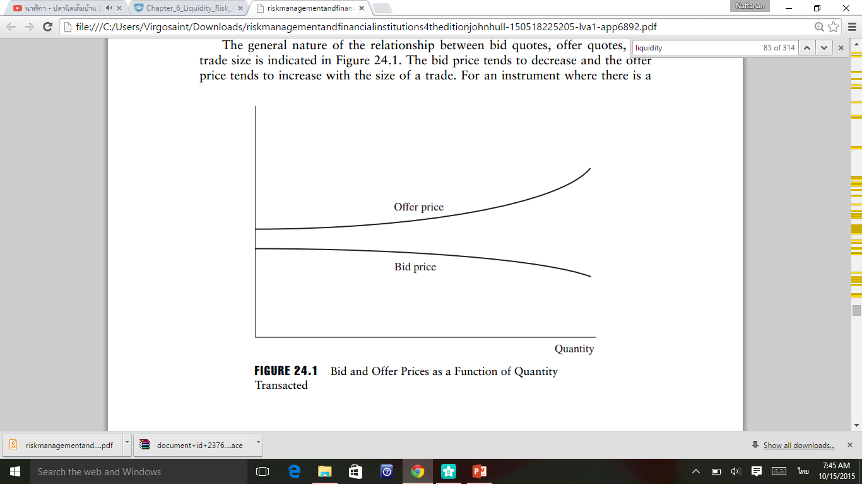
Liquidity Risk
Liquidity Risk in Trading
When there is no market maker for a financial instrument, there is still an implicit bid–offer spread. If a financial institution approaches another financial institution (or an interdealer broker) to do a trade, the price depends on which side of the trade it wants to take. The bid–offer spread for an asset can vary from 0.05% of the asset’s mid-market price to as much as 5%, or even 10%, of its mid-market price.

Slide 10
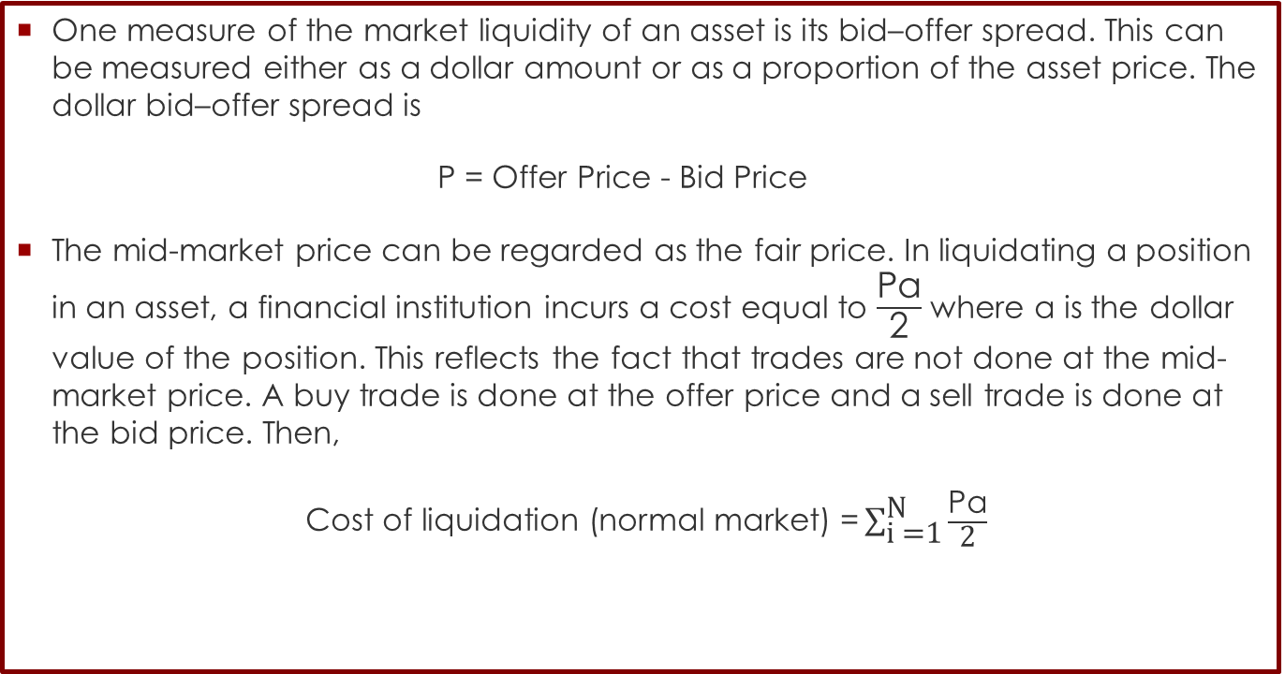
Liquidity Risk
Measuring Market Liquidity
One measure of the market liquidity of an asset is its bid–offer spread. This can be measured either as a dollar amount or as a proportion of the asset price. The dollar bid–offer spread is
P = Offer Price - Bid Price
The mid-market price can be regarded as the fair price. In liquidating a position in an asset, a financial institution incurs a cost equal to $\frac{\text{Pα}}{\text{2}}$ where α is the dollar value of the position. This reflects the fact that trades are not done at the mid-market price. A buy trade is done at the offer price and a sell trade is done at the bid price. Then,
$\text{Cost} \text{of} \text{liquidation}\text{ (}\text{normal} \text{market}\text{) =}\sum_{\text{i} \text{=1}}^{\text{N}}{\frac{\text{Pα}}{\text{2}}}$

Slide 11
Liquidity Risk
Measuring Market Liquidity
Note that although diversification reduces market risk, it does not necessarily reduce liquidity trading risk. However, as explained earlier, s increases with the size of position i. Holding many small positions rather than a few large positions therefore tends to entail less liquidity risk. Setting limits to the size of any one position can therefore be one way of reducing liquidity trading risk.
Ex. Suppose that a financial firm has bought 10 million shares of one company and 50 mil. ounces of a commodity. The shares are bid $89.5, offer $90.5. The commodity is bid $15, offer $15.1. The cost of liquidation in a normal market is
(90.5-89.5) ∕ 2 × 10m + (15.1-15) / 2 × 50 m= 7.5 or $7.5 million

Slide 12
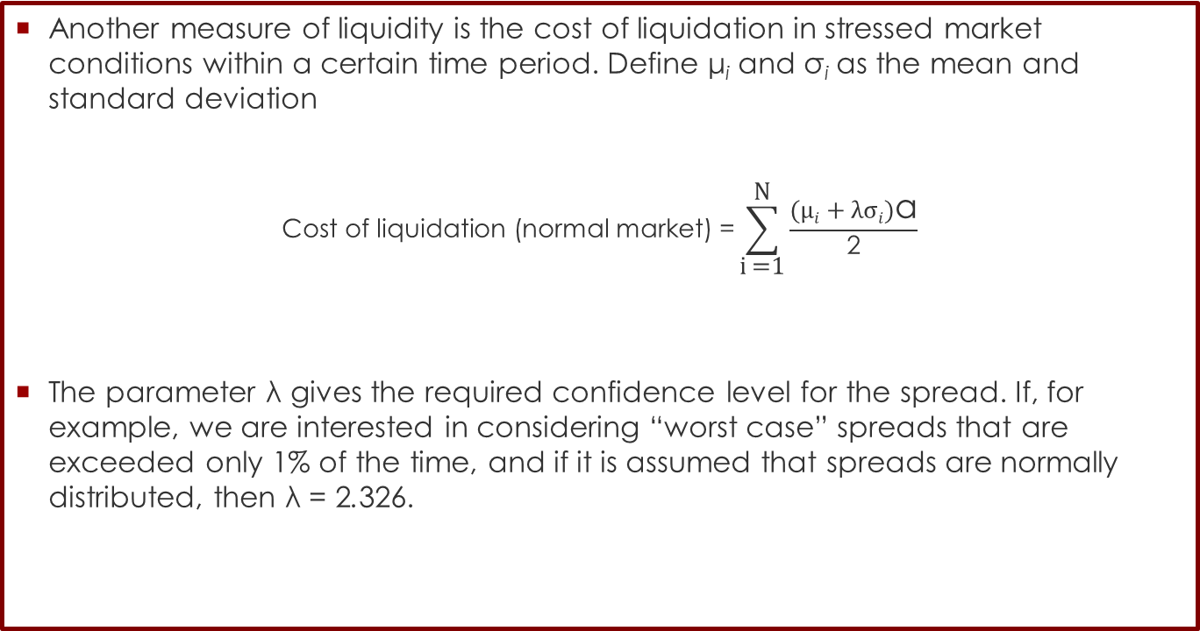
Liquidity Risk
Measuring Market Liquidity
Another measure of liquidity is the cost of liquidation in stressed market conditions within a certain time period. Define μ_{i} and σ_{i} as the mean and standard deviation
$$\text{Cost} \text{of} \text{liquidation}\text{ (}\text{normal} \text{market}\text{) =}\sum_{\text{i} \text{=1}}^{\text{N}}{\frac{(µi+λσi)\text{α}}{\text{2}}}$$
The parameter λ gives the required confidence level for the spread. If, for example, we are interested in considering “worst case” spreads that are exceeded only 1% of the time, and if it is assumed that spreads are normally distributed, then λ = 2.326.

Slide 13
Liquidity Risk
Measuring Market Liquidity
Suppose that in Example 24.1 the mean and standard deviation for the bid–offer spread for the shares are $1.0 and $2.0, respectively. Suppose further that the mean and standard deviation for the bid–offer spread for the commodity are both $0.1. Assuming the spreads are normally distributed, the cost of liquidation that we are 99% confident will not be exceeded is
0.5× 10 ×(1 + 2.326 × 2 )+0.5× 50 ×(0.1 + 2.326 × 0.1) = 36.58
or $36.58 million. This is almost five times the cost of liquidation in normal market conditions.

Slide 14
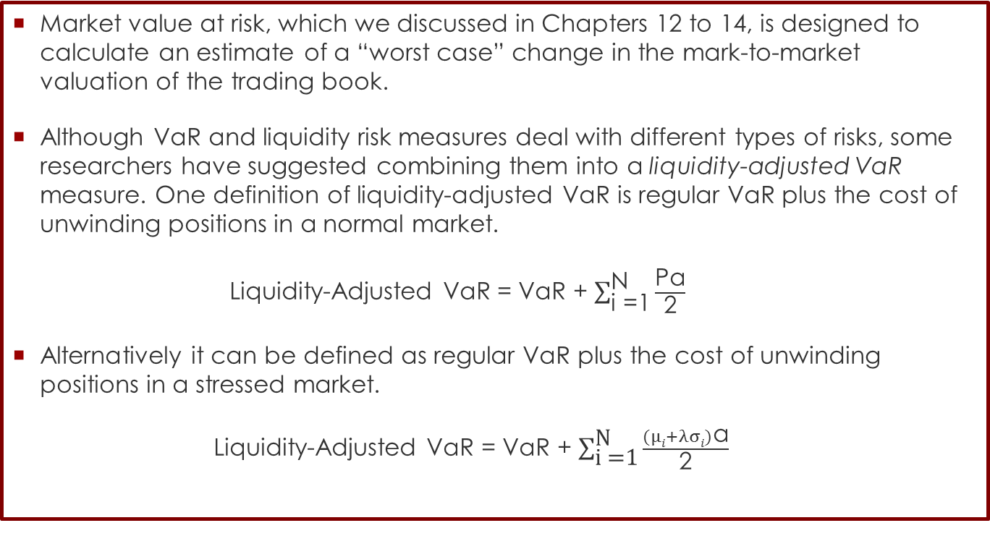
Liquidity Risk
Liquidity-Adjusted VaR
Market value at risk, which we discussed in Chapters 12 to 14, is designed to calculate an estimate of a “worst case” change in the mark-to-market valuation of the trading book.
Although VaR and liquidity risk measures deal with different types of risks, some researchers have suggested combining them into a liquidity-adjusted VaR measure. One definition of liquidity-adjusted VaR is regular VaR plus the cost of unwinding positions in a normal market.
Liquidity-Adjusted VaR = VaR + $\sum_{\text{i} \text{=1}}^{\text{N}}{\frac{\text{P}\text{α}}{\text{2}}}$
Alternatively it can be defined as regular VaR plus the cost of unwinding positions in a stressed market.
Liquidity-Adjusted VaR = VaR + $\sum_{\text{i} \text{=1}}^{\text{N}}{\frac{(µi+λσi)\text{α}}{\text{2}}}$

Slide 15
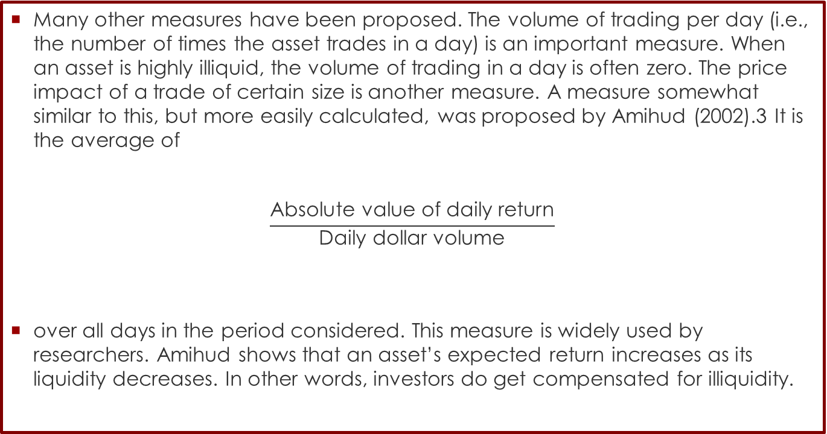
Liquidity Risk
Liquidity-Adjusted VaR
Many other measures have been proposed. The volume of trading per day (i.e., the number of times the asset trades in a day) is an important measure. When an asset is highly illiquid, the volume of trading in a day is often zero. The price impact of a trade of certain size is another measure. A measure somewhat similar to this, but more easily calculated, was proposed by Amihud (2002).3 It is the average of
$$\frac{\text{Absolute} \text{value} \text{of} \text{daily} \text{return}}{\text{Daily} \text{dollar} \text{volume}}$$
over all days in the period considered. This measure is widely used by researchers. Amihud shows that an asset’s expected return increases as its liquidity decreases. In other words, investors do get compensated for illiquidity.

Slide 16
Liquidity Risk
LIQUIDITY Risk in Banking
LIQUIDITY risk is that bank has insufficient funding to met commitments as they arise. Meaning:
  The bank is not able to attract additional funding
  The bank does not have sufficient liquid assets
  The bank is not able to get liquidity quickly and if yes for a very high price
Banking book – assets and liabilities of the banks resulted from customer and bank´s activities. Managed by Assets and Liabilities department (ALM). Liquidity is managed by ALM for the whole bank.
Trading book –Financial instruments in a trading book are purchased or sold to facilitate trading for the institution's customers or on banks account, to profit from trading spreads between the bid and ask prices, or to hedge against various types of risk. Managed by dealing rooms – valuated daily into P/L.

Slide 17
Liquidity Risk
LIQUIDITY Risk in Banking
Asset
Liability/ Equity
Cash
Retail Client´s deposits
Current accounts
Saving accounts
Term accounts
Retail Loan
Mortgage
Consumer Finance
Credit Card
Corporate clients, deposits
Current accounts
Term accounts
Corporate Loan
Revolving
Investment Loans...
Issued Bonds
Promissory notes
Issued mortgage bonds
Government bonds and other investments
Capital

Slide 18
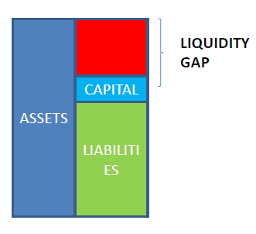
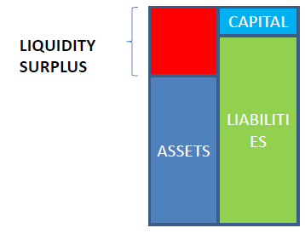
Liquidity Risk
LIQUIDITY Risk in Banking
Liquidity gap/surplus – mismatch between assets and liablities
Structural liquidity gap – mismatch between term structure of assets and liabilities

Slide 19
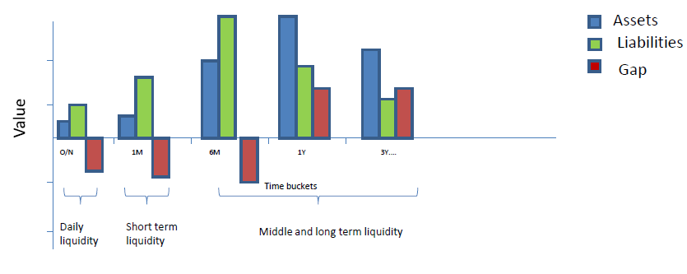
Liquidity Risk
LIQUIDITY Risk in Banking
Based on expiration of assets and liabilities Risk prepare liquidity gaps by tenors. Liquidity gap is difference between assets and liabilities in the relevant time buckets.

Slide 20
Liquidity Risk
LIQUIDITY FUNDING
The main sources of liquidity for a financial institution are:
Holdings of cash and Treasury securities that can be readily convertible into cash
The ability to liquidate trading book positions
The ability to borrow money at short notice
The ability to offer favorable terms to attract retail and wholesale deposits at short notice
The ability to securitize assets (such as loans) at short notice
Borrowings from the central bank

Slide 21
Liquidity Risk
Cash and Treasury Securities
Cash and Treasury securities are excellent sources of liquidity. Cash is of course always available to meet liquidity needs and Treasury securities issued by countries such as the United States and the United Kingdom can generally be converted into cash at short notice without any problem.
However, cash and Treasury securities are relatively expensive sources of liquidity. There is a trade off between the liquidity of an asset and the return it provides.
In order to be profitable, a financial institution needs to invest in assets such as loans to corporations that provide a higher rate of return than Treasury instruments. There is therefore a limit to the cash and Treasury securities that can reasonably be held.

Slide 22
Liquidity Risk
Liquidating Trading Book Positions
Liquidity funding risk is related to liquidity trading risk because one way a financial institution can meet its funding requirements is by liquidating part of its trading book.
It is therefore important for a financial institution to quantify the liquidity of its trading book so that it knows how easy it would be to use the book to raise cash.
The financial institution wants to make sure that it will be able to survive stressed market conditions where there is a general shortage of liquidity.
The financial institution’s analysis should therefore be based on stressed market conditions, not normal market conditions.
This is the reason why the measures discussed in the previous section concerned with bid–offer spreads in stressed markets are important.

Slide 23
Liquidity Risk
Ability to Borrow
When markets are unstressed, a creditworthy bank usually has no problem in borrowing money, but in stressed market conditions there is a heightened aversion to risk.
This leads to higher interest rates, shorter maturities for loans, and in some cases a refusal to provide funds at all.
Financial institutions should monitor the assets that can be pledged as collateral for loans at short notice.
A financial institution can (at a cost) mitigate its funding risks somewhat by arranging lines of credit.
For example, Countrywide, an originator of mortgages in the United States, had a syndicated loan facility of $11.5 billion, which it was able to use during the credit crisis of 2007. (This helped keep the company afloat, but it still experienced significant problems and was taken over by Bank of America in January 2008.)

Slide 24
Liquidity Risk
Securitization
Rather than keep illiquid assets such as loans on their balance sheet, they have securitized them.
Securitization led to other liquidity problems in August 2007.
Banks had entered into liquidity backstop arrangements on the asset-backed commercial paper (ABCP) that was used to fund debt instruments, such as mortgages, prior to their securitization.
When buyers could not be found, they had to buy the instruments themselves. In some cases, in order to avoid their reputations being adversely impacted, they had to provide financial support to conduits and other off-balance sheet vehicles that were involved in securitization, even though not legally required to do so.

Slide 25
Liquidity Risk
Reference
http://www.aaii.com/computerizedinvesting/article/liquidity-ratio-analysis
Hull, J. (2012). Risk Management and Financial Institutions,+ Web Site (Vol. 733). John Wiley & Sons.
Chapman, R. J. (2011). Simple tools and techniques for enterprise risk management. John Wiley & Sons.
Martina Hervayová ,Vladimír Šošovička (n.d), Risk management in the banking and Insurance sector : CSOB case studies

